Slide 1
    Different Units
Ramakrishna Vedantam

Slide 2

  Motivation
Recurrent Neural Nets are an extremely powerful class of models
Useful for a lot of tasks, turing complete in the space of programs

Slide 3
However, RNN’s are difficult to train
(as seen in previous classes)

Slide 4
Architectures to facilitate learning/representation
Long Short-Term Memory
Hochreiter and Schmidhuber, 1997
Bidirectional RNN’s
Schuster and Paliwal, 1997
Gated Feedback Recurrent Neural Networks
Chung et.al., 2015
Tree Structured LSTM
Kai et.al., 2015
Multi-Dimensional RNN’s
Graves et.al., 2007

Slide 5
Long Short-Term Memory (LSTM)
RNN’s use the hidden state to store representations of recent inputs (“short term memory”)
This is as opposed to long term memory (stored in weights)
How do we enhance the short term memory of an RNN, so that it is useful for noisy inputs, and long range dependencies?
Long Short-Term Memory!

Slide 6
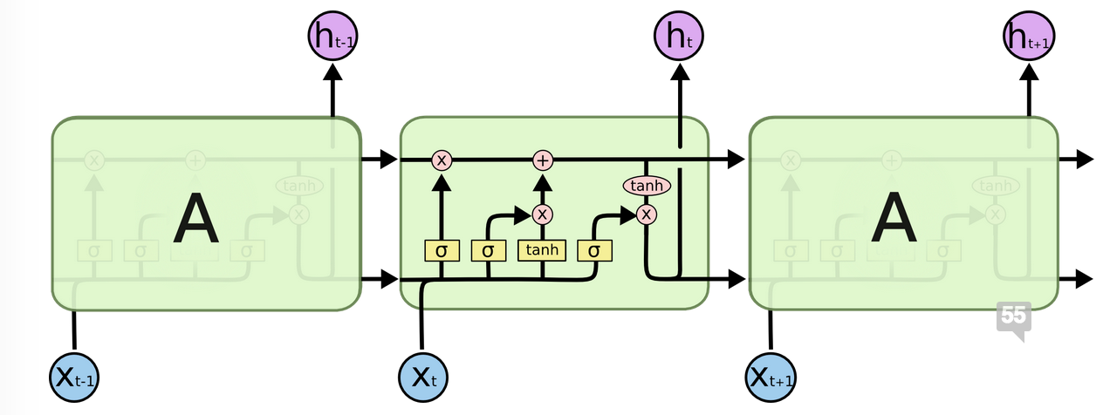
Image credit: Chris Olah

Slide 7
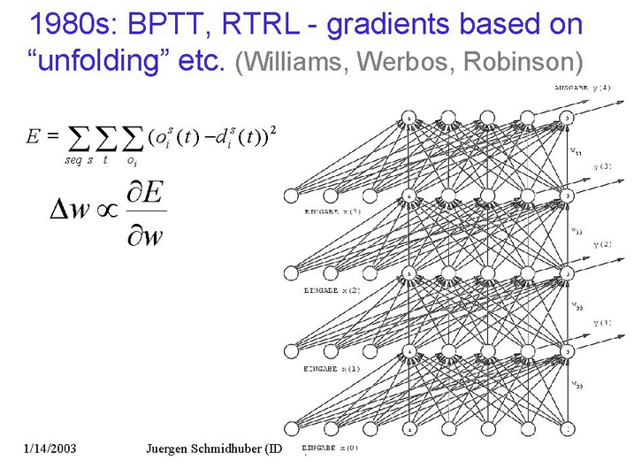
Exploding Gradients
Vanishing Gradients
  Slide credit: Juergen Schmidhuber

Slide 8
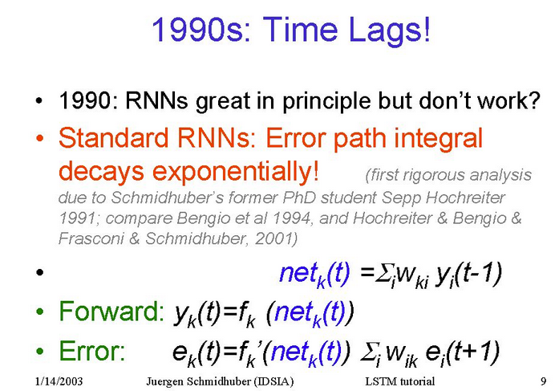

Slide 9
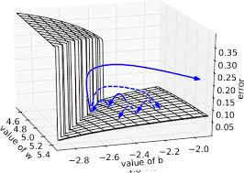
From Dhruv’s Lecture

Slide 10
LSTM
Can bridge time intervals in excess of 1000 steps
Handles noisy inputs
without compromising on short time lag capabilities
Architecture, and learning algorithm can set up constant error - carousels for error to back propagate

Slide 11
Constant Error Carousel
For a linear unit, if the activation remains the same,
the error passes back unaffected.

Slide 12
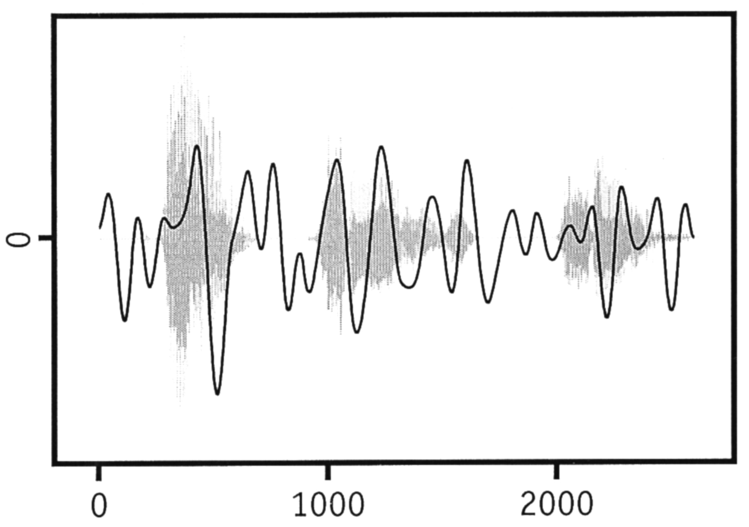
c
a
t
c
a
r

Slide 13
Limitation for any sequential RNN.

Slide 14
Naive Solution
Use hidden states for a fixed offset (t + M) when making predictions at t
Problem
M becomes a hyper-parameter to cross-validate*
Different for different tasks
*Sorry, Dhruv! :)
Notes:
Although Dhruv would tell you that is not an issue at all. (Div-M-best)

Slide 15
Another Solution
Use two RNN’s one forward, one backward
Average the predictions, treating as an ensemble
Problem
Not a true ensemble, inputs different at test time
Not clear if averaging makes sense

Slide 16
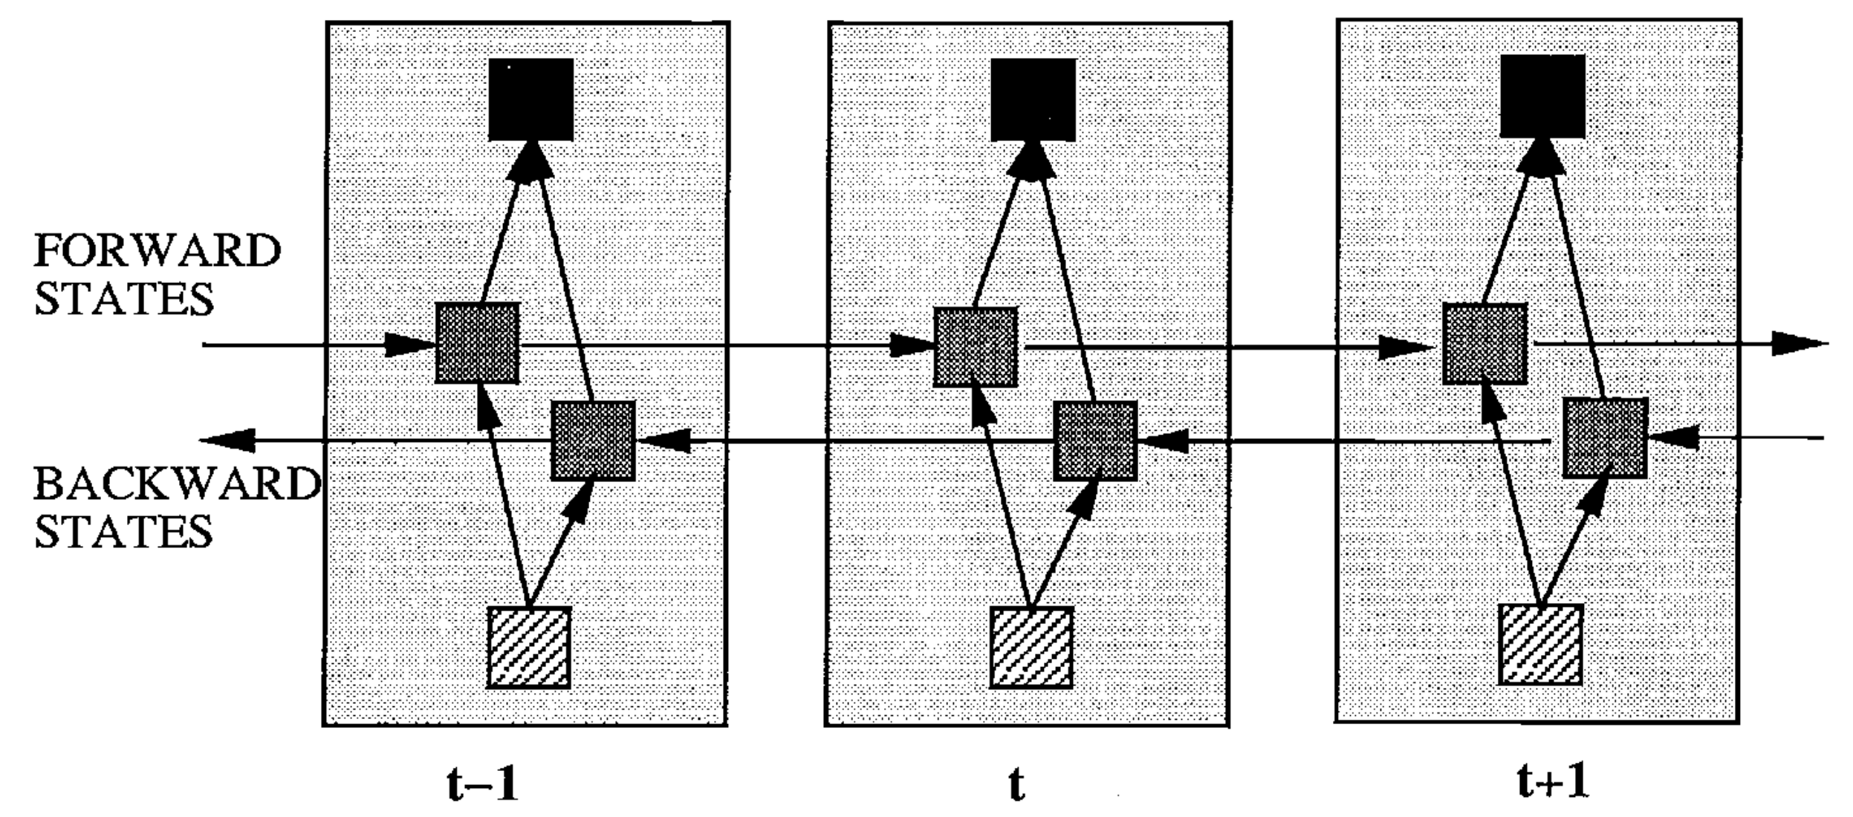
Bidirectional RNN
Simple Idea:
Split hidden state into half forward and half backward
Image credit: BRNN Paper

Slide 17
Next Question.

Slide 18
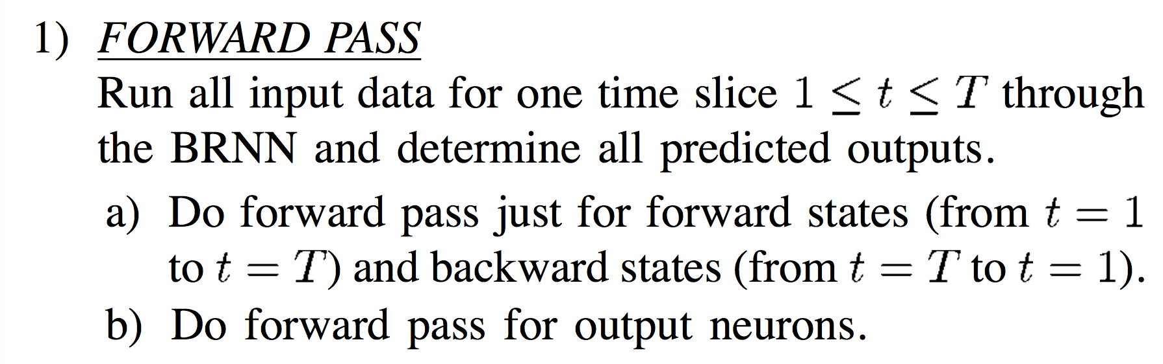
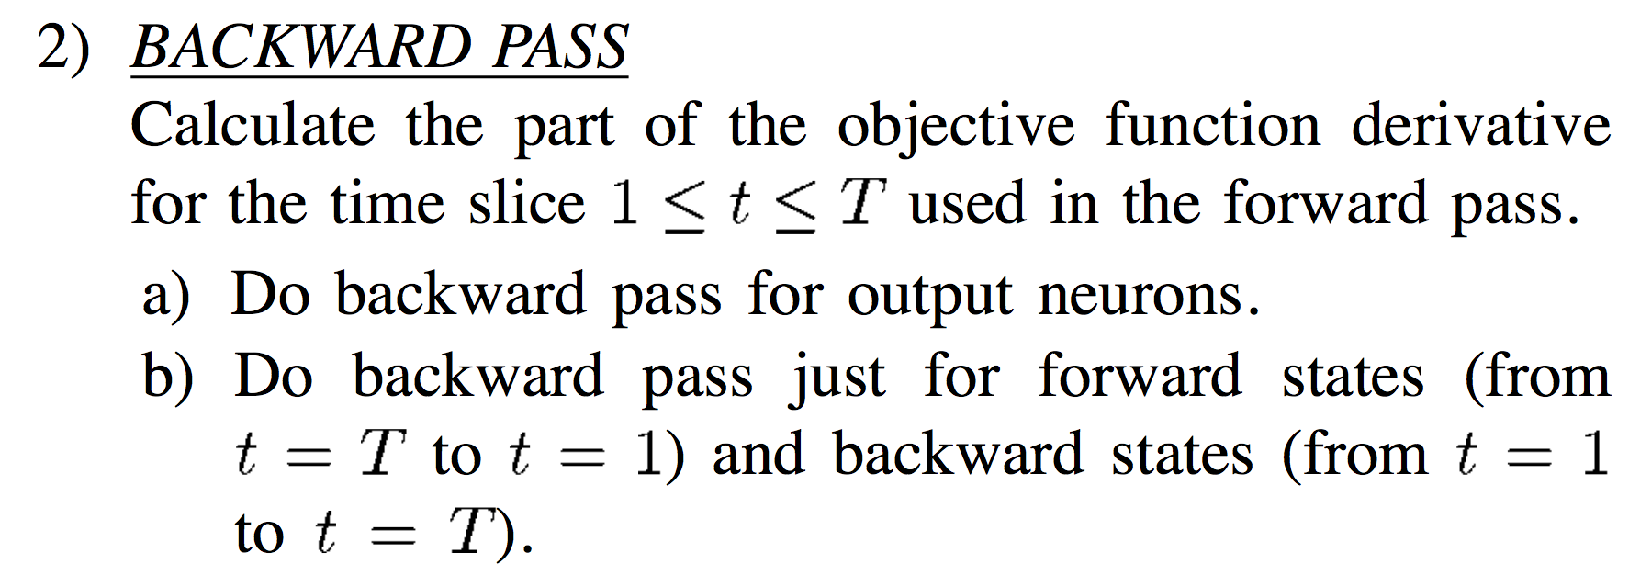
How would we do the forward pass?
How would we do the backward pass?

Slide 19
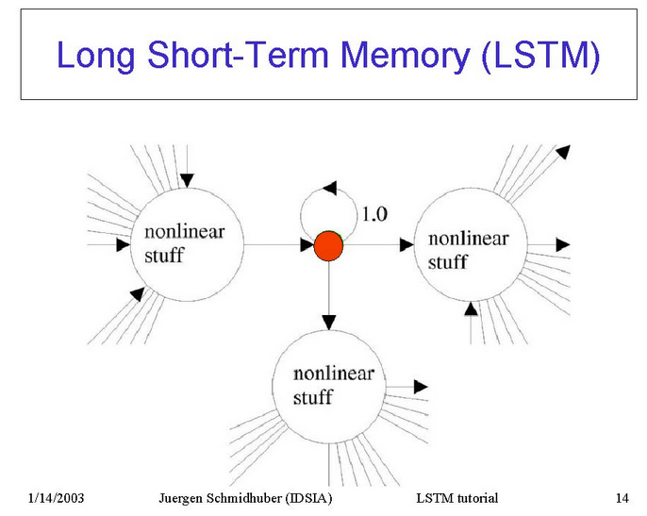

Slide 20
Still, there is a problem.

Slide 21


t_50
t_100
Output:
read gate
Hidden
State:
h_10
write gate
i
k
Input:
Read and Write Gates!

Slide 22
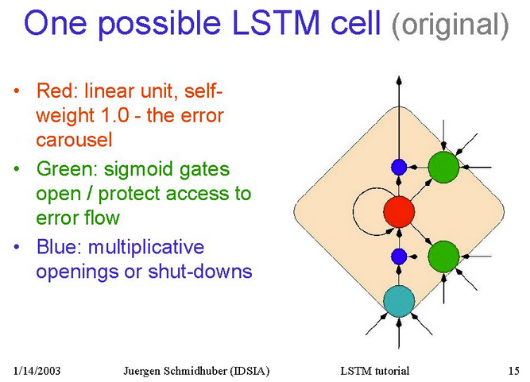

Slide 23
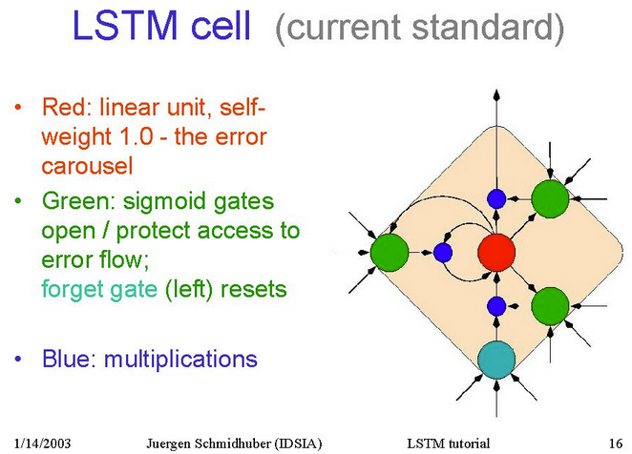

Slide 24
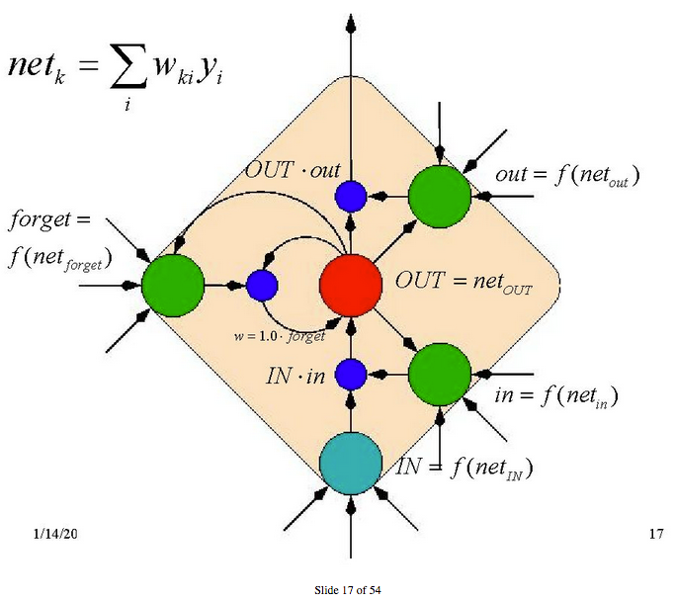
Notes:
Everything can be learnt via backprop
Show how gradient just gets scaled by a constant and gets stored until the forget signal comes in during backprop

Slide 25
Training Issues
At the beginning of training, error reduction might be possible without “remembering” anything
Thus, the memory cell maybe abused as a “bias” unit modulated by multiplicative interactions
Solution: set the output bias to a negative value. Experiments show an LSTM unit with negative output bias learns faster.
Gers. et.al (2000) also advocate adding a bias of 1 to the forget gate
Truncated BPTT is typically used to train, although the paper uses RTRL (Real-time recurrent learning)

Slide 26
Some Limitations
LSTM typically behaves like a feedforward net trained by backprop that sees the entire input.
LSTM cannot distinguish if an input occurred 99 timesteps ago, or 100 time steps ago. Gradient based approaches find it difficult to count discrete time steps.

Slide 27
LSTM Advantages
Constant error carousels can help LSTM bridge large time gaps
LSTM can handle noise, distributed representations, and continuous values (unlike HMM’s)
There appears to be no need for parameter fine tuning
LSTM’s update complexity is same as BPTT

Slide 28
LSTM Applications
Handwriting recognition (Graves et.al)
Machine Translation (Sutskever et.al)
Speech recognition (Graves et.al)
Image Captioning (Vinyals et.al)
and potentially many more !

Slide 29

Fast forward 18 years

Slide 30
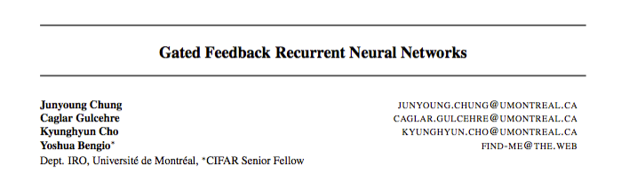
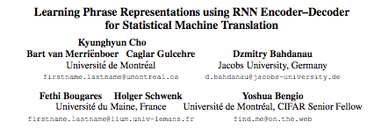
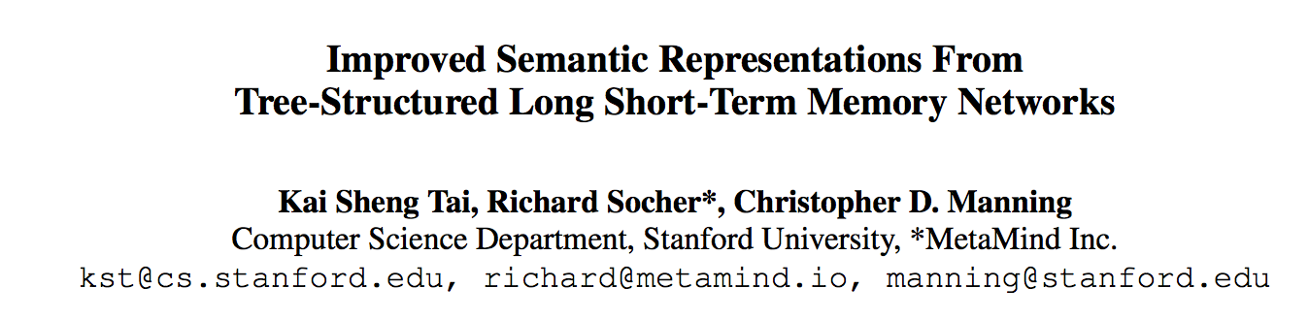
Different Units Today
GF RNN
GRU
Tree RNN

Slide 31
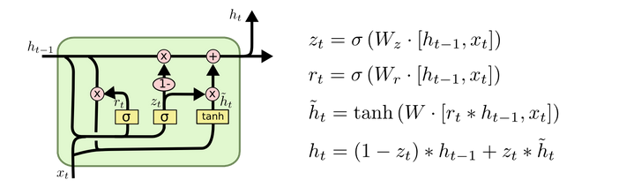
Gated Recurrent Unit (GRU)
Update gate : z
Reset gate : r
Figure credit: Chris Olah
Notes:
Reset gate helps ignore previous hidden states
Update gate modulates how much of the previous hidden state and how much of the present hidden state need to be mixed

Slide 32
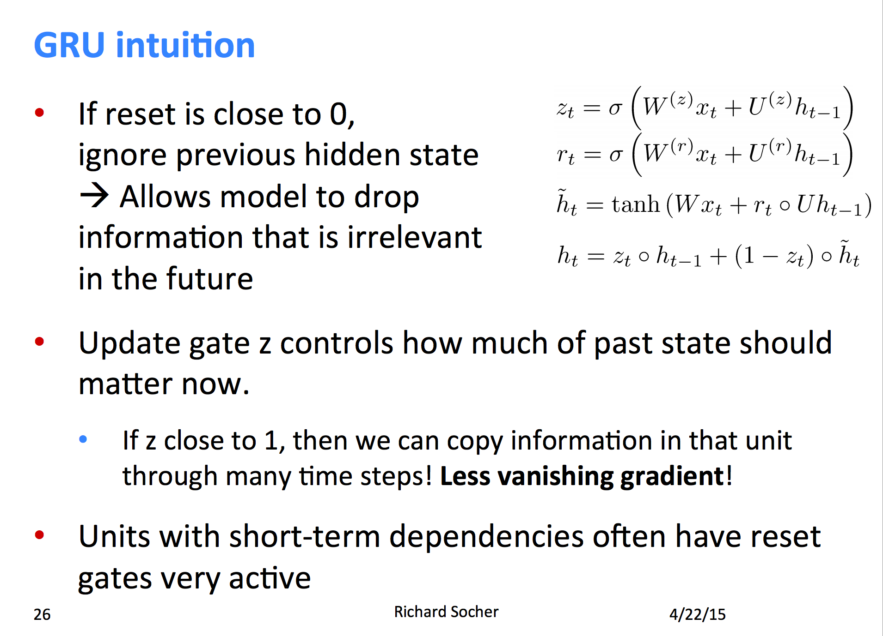

Slide 33
Gated Feedback RNN
(GF-RNN)
People have been using “stacked” RNN’s for a while
The idea is that the temporal dependencies resolve in a hierarchy (Bengio et.al)

Slide 34
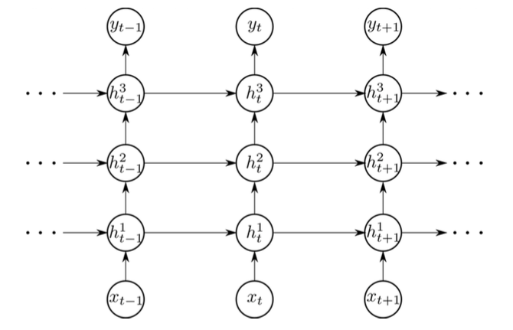
RNN
Stack

Slide 35
Gated Feedback RNN
People have been using “stacked” RNN’s for a while
The idea is that the temporal dependencies resolve in a hierarchy
Recent work proposed a CW-RNN where units were updated in intervals of 2^i
(where i ranges from 1 to N)

Slide 36
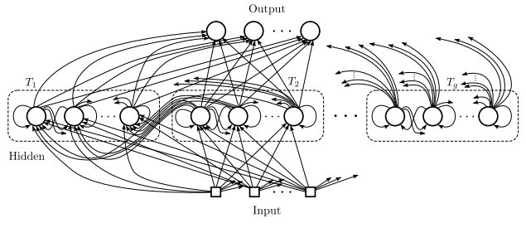

Slide 37
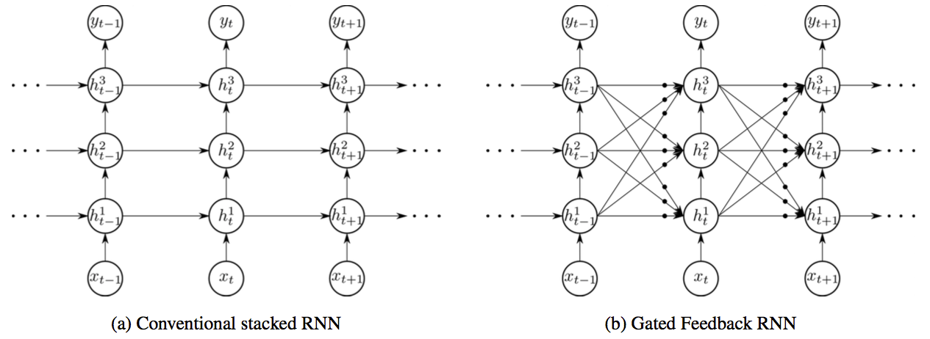

Gated Feedback RNN
(GF-RNN)
g^{3->3}
Global Reset Gate
Notes:
Can we learn CW-RNN like interactions?

Slide 38



  GF-RNN
With the feedback links between stacks, GF-RNN can be applied to various models
LSTM, GRU and vanilla RNN are explored:
Vanilla RNN
LSTM
GRU

Slide 39
Experiments
Character level language modeling
Python program evaluation
Training objective: negative log likelihood of sequences
Evaluation metric: BPC (Bits Per Character)

Slide 40
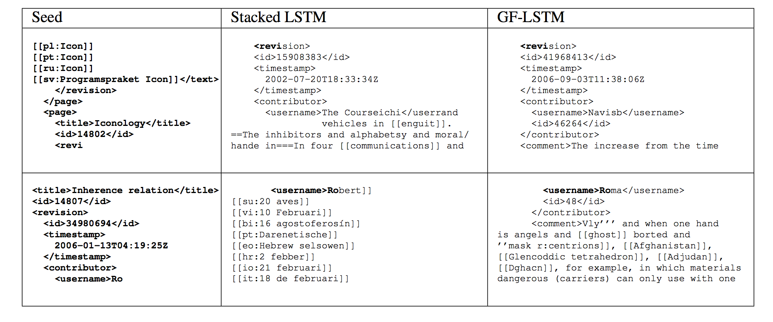
Figure credit: Main Paper

Slide 41
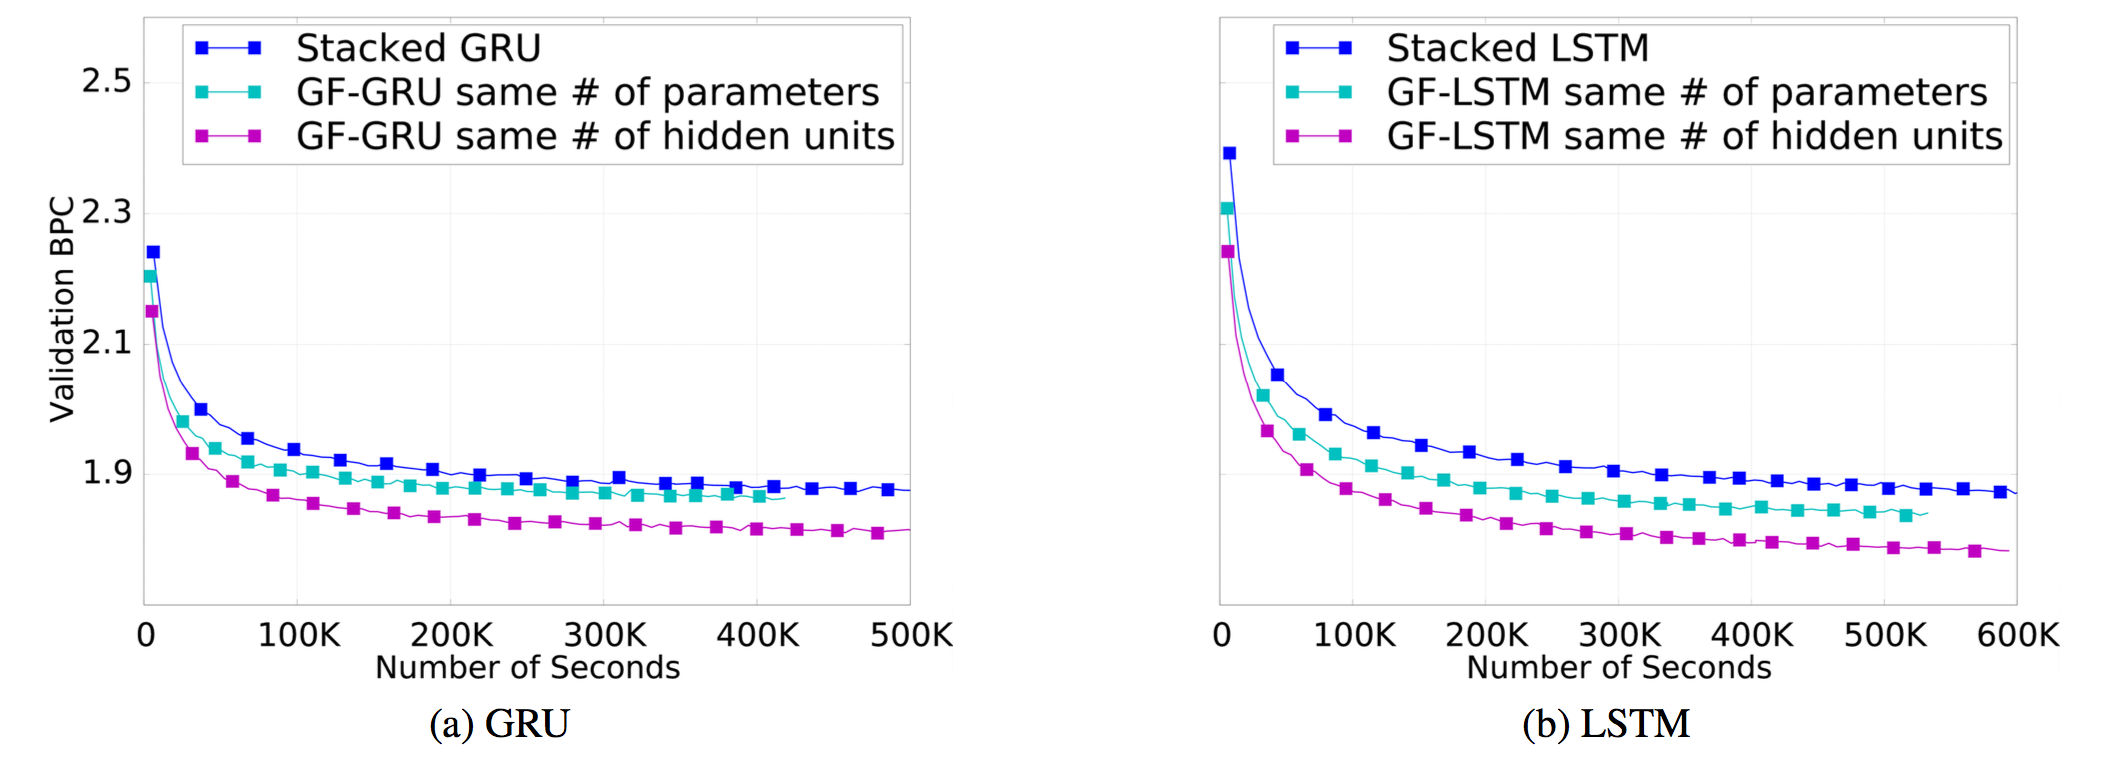
Validation BPC

Slide 42
Effect of Global Reset Gates

Slide 43
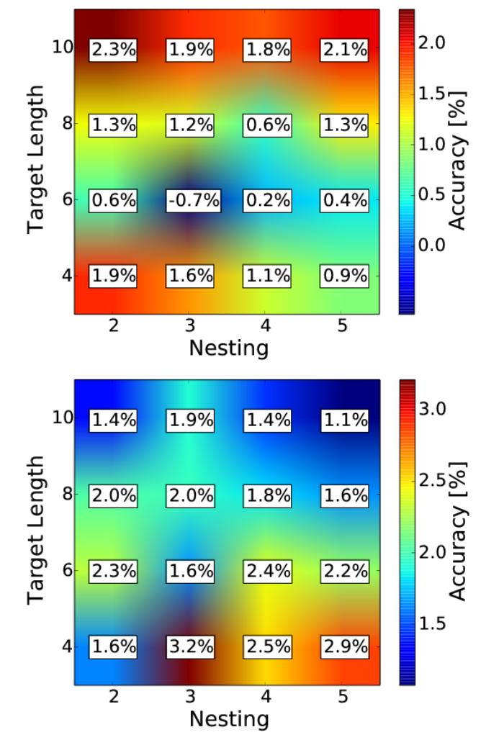
Python Program Evaluation

Slide 44
An RNN that is not an RNN
We use RNN’s after unrolling them, in any case
Why bother with unrolling one?

Slide 45
Meet Tree RNN

Slide 46
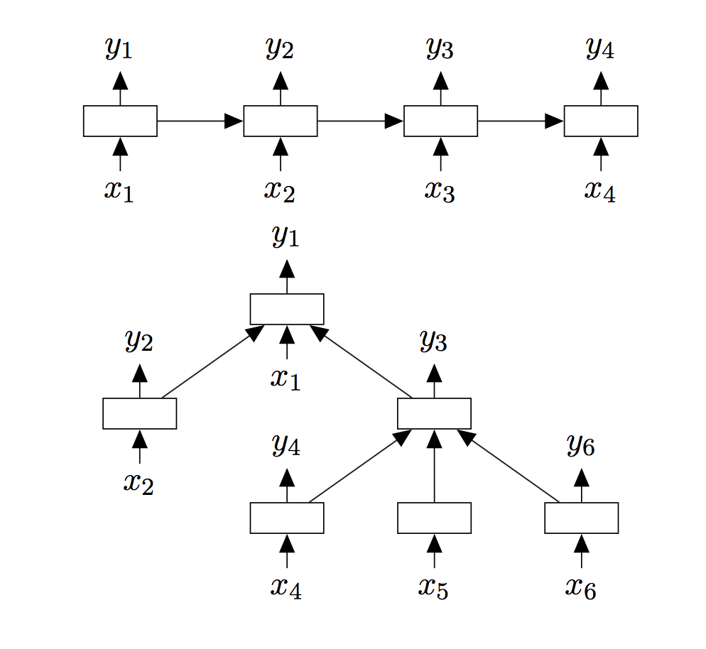

Slide 47
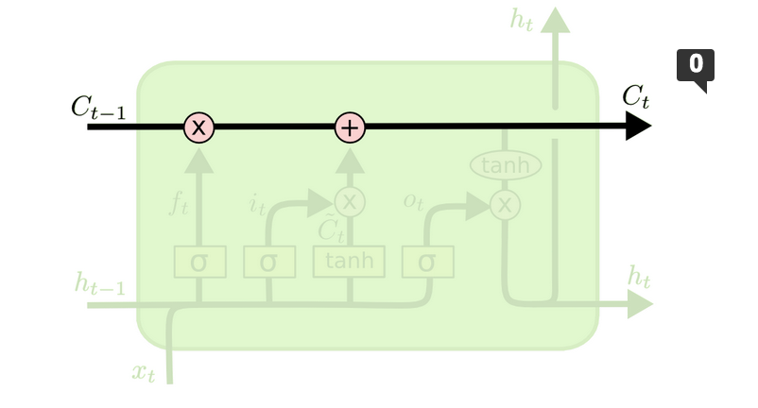
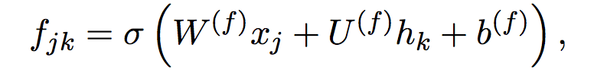
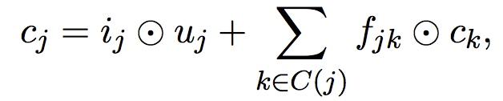

Slide 48
Tree RNN
State of the art / close to it on Semantic Relatedness, and sentiment classification benchmarks

Slide 49
Many more!
Check out this link for more awesome RNN’s:
https://github.com/kjw0612/awesome-rnn
Notes:
Thanks to Dhruv!

Slide 50
Thank You!

