Slide 1
ECE 6504: Deep Learning for Perception
Topics:
  Recurrent Neural Networks (RNNs)
  BackProp Through Time (BPTT)
  Vanishing / Exploding Gradients
  [Abhishek:] Lua / Torch Tutorial
Dhruv Batra
Virginia Tech

Slide 2
Administrativia
HW3
  Out today
  Due in 2 weeks
  Please please please please please start early
  https://computing.ece.vt.edu/~f15ece6504/homework3/

Slide 3
Plan for Today
Model
  Recurrent Neural Networks (RNNs)
Learning
  BackProp Through Time (BPTT)
  Vanishing / Exploding Gradients
[Abhishek:] Lua / Torch Tutorial

Slide 4
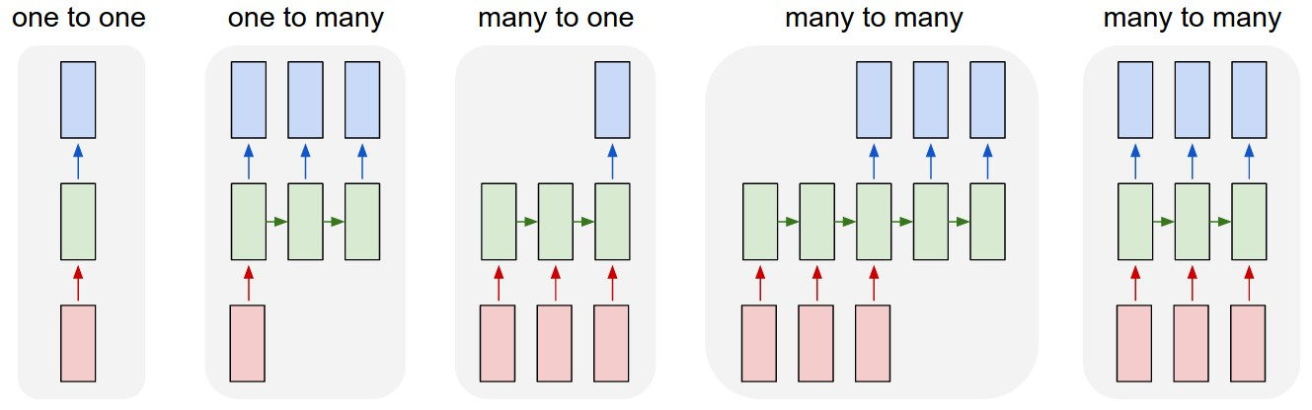
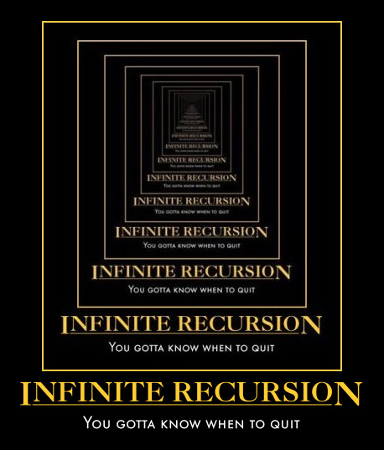
New Topic: RNNs
Image Credit: Andrej Karpathy

Slide 5
Synonyms
Recurrent Neural Networks (RNNs)
Recursive Neural Networks
  General familty; think graphs instead of chains
Types:
  Long Short Term Memory (LSTMs)
  Gated Recurrent Units (GRUs)
  Hopfield network
  Elman networks
  …
Algorithms
  BackProp Through Time (BPTT)
  BackProp Through Structure (BPTS)

Slide 6
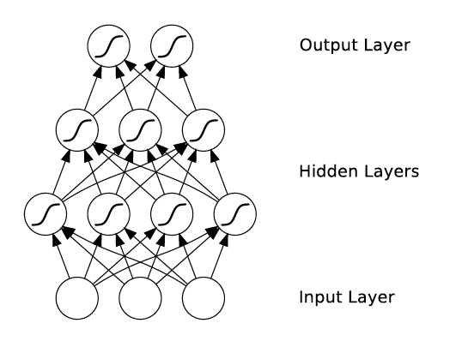
What’s wrong with MLPs?
Problem 1: Can’t model sequences
  Fixed-sized Inputs & Outputs
  No temporal structure
Problem 2: Pure feed-forward processing
  No “memory”, no feedback
Image Credit: Alex Graves, book

Slide 7
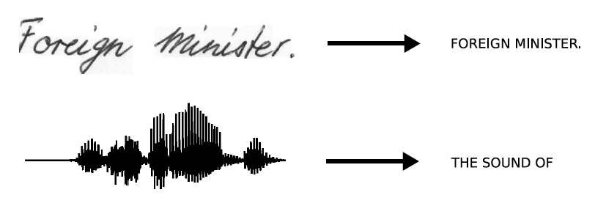
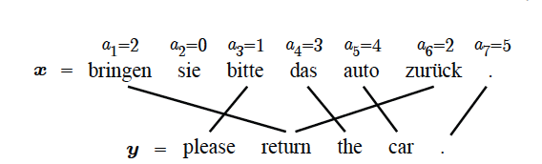
Sequences are everywhere…
Image Credit: Alex Graves and Kevin Gimpel

Slide 8
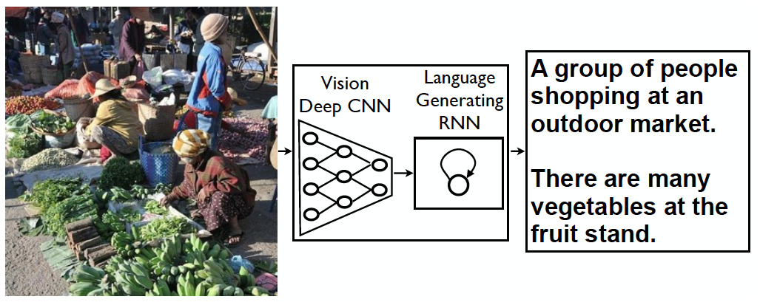
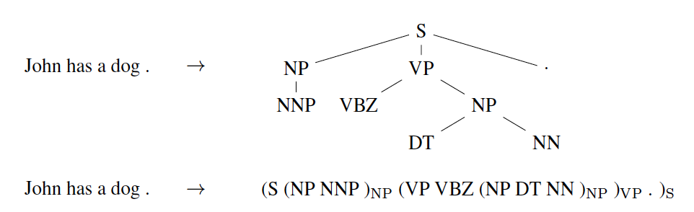
Even where you might not expect a sequence…
Image Credit: Vinyals et al.

Slide 9
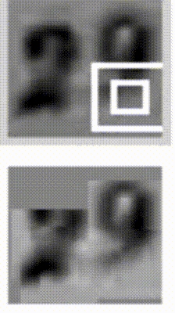
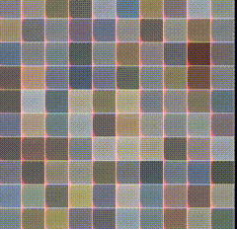
Even where you might not expect a sequence…
Input ordering = sequence
Image Credit: Ba et al.; Gregor et al

Slide 10
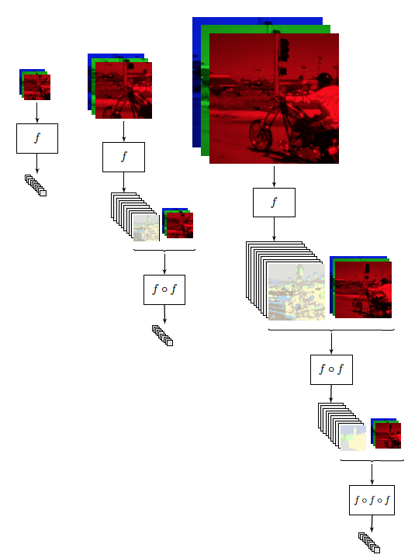
Image Credit: [Pinheiro and Collobert, ICML14]

Slide 11
Why model sequences?
Figure Credit: Carlos Guestrin

Slide 12
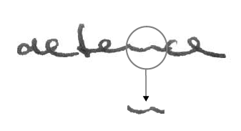
Why model sequences?
Image Credit: Alex Graves

Slide 13
Name that model
Y₁ = {a,…z}
Y₂ = {a,…z}
Y₃ = {a,…z}
Y₄ = {a,…z}
Y₅ = {a,…z}
X₁ =
X₂ =
X₃ =
X₄ =
X₅ =
Hidden Markov Model (HMM)
Figure Credit: Carlos Guestrin

Slide 14

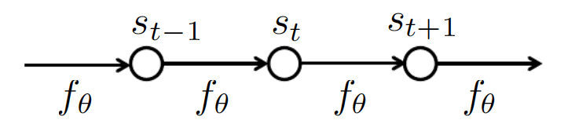
How do we model sequences?
No input
Image Credit: Bengio, Goodfellow, Courville

Slide 15

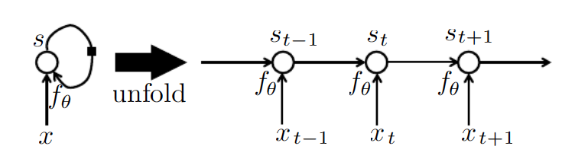
How do we model sequences?
With inputs
Image Credit: Bengio, Goodfellow, Courville

Slide 16
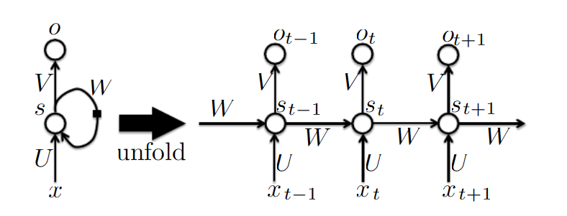
How do we model sequences?
With inputs and outputs
Image Credit: Bengio, Goodfellow, Courville

Slide 17
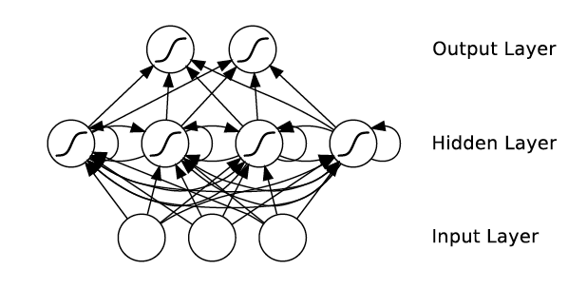
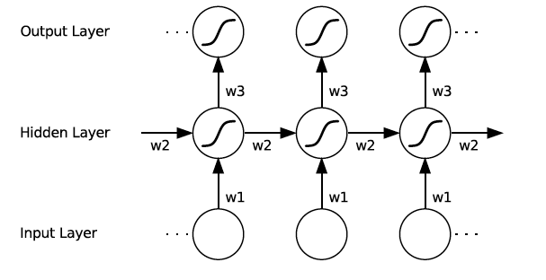
How do we model sequences?
With Neural Nets
Image Credit: Alex Graves

Slide 18
How do we model sequences?
It’s a spectrum…
Input: No sequence
Output: No sequence
Example: “standard” classification /
regression problems
Input: No sequence
Output: Sequence
Example: Im2Caption
Input: Sequence
Output: No sequence
Example: sentence classification, multiple-choice question answering
Input: Sequence
Output: Sequence
Example: machine translation, video captioning, open-ended question answering, video question answering
Image Credit: Andrej Karpathy

Slide 19
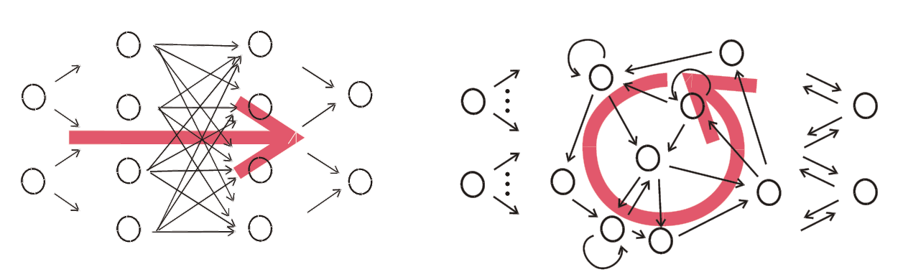
Things can get arbitrarily complex
Image Credit: Herbert Jaeger

Slide 20
Key Ideas
Parameter Sharing + Unrolling
  Keeps numbers of parameters in check
  Allows arbitrary sequence lengths!
“Depth”
  Measured in the usual sense of layers
  Not unrolled timesteps
Learning
  Is tricky even for “shallow” models due to unrolling

Slide 21
Plan for Today
Model
  Recurrent Neural Networks (RNNs)
Learning
  BackProp Through Time (BPTT)
  Vanishing / Exploding Gradients
[Abhishek:] Lua / Torch Tutorial

Slide 22
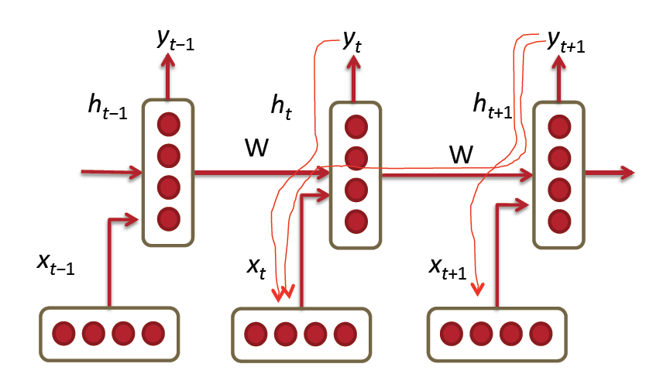
BPTT
a
Image Credit: Richard Socher

Slide 23
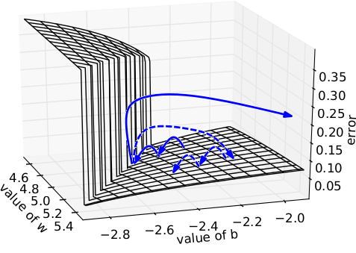
Illustration [Pascanu et al]
Intuition
    Error surface of a single hidden unit RNN; High curvature walls
    Solid lines: standard gradient descent trajectories
    Dashed lines: gradient rescaled to fix problem

Slide 24
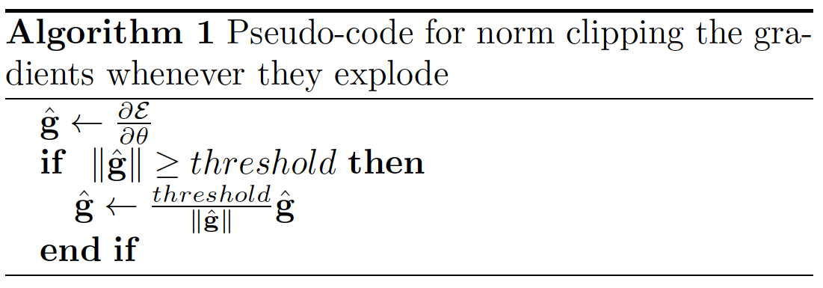
Fix #1
Pseudocode
Image Credit: Richard Socher

Slide 25
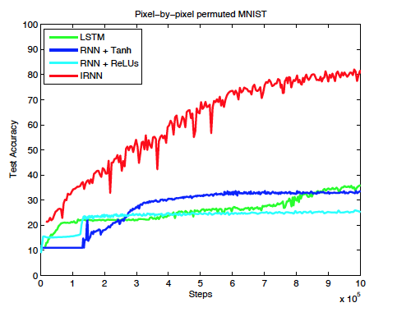
Fix #2
Smart Initialization and ReLus
  [Socher et al 2013]
  A Simple Way to Initialize Recurrent Networks of Rectified Linear Units, Le et al. 2015

