Slide 1
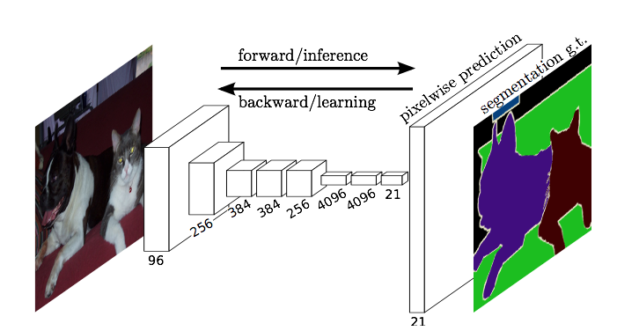
Fully Convolutional Networks for Semantic Segmentation
Jonathan Long* Evan Shelhamer* Trevor Darrell
UC Berkeley
Presented by: Gordon Christie
Slide credit: Jonathan Long
Notes:
Goal of work is to use FCn to predict class at every pixel
Transfer existing classification models to dense prediction tasks

Slide 2
Overview
Reinterpret standard classification convnets as “Fully convolutional” networks (FCN) for semantic segmentation
Use AlexNet, VGG, and GoogleNet in experiments
Novel architecture: combine information from different layers for segmentation
State-of-the-art segmentation for PASCAL VOC 2011/2012, NYUDv2, and SIFT Flow at the time
Inference less than one fifth of a second for a typical image
Slide credit: Jonathan Long
Notes:
Note that using existing networks is transfer learning

Slide 3
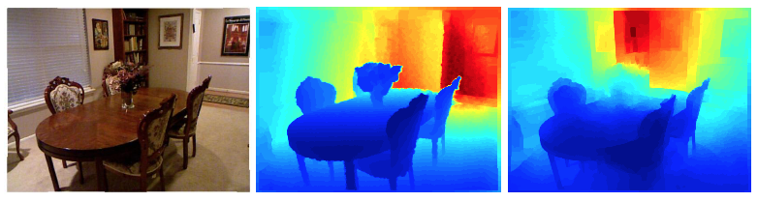

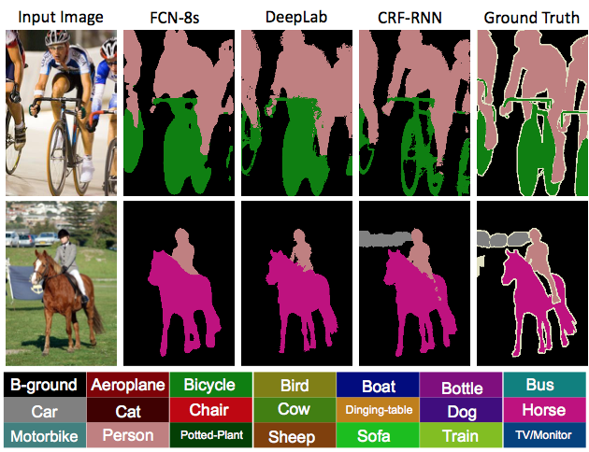
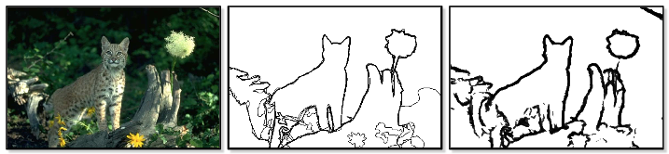
pixels in, pixels out
monocular depth estimation (Liu et al. 2015)
semantic
segmentation
Slide credit: Jonathan Long
boundary prediction (Xie & Tu 2015)

Slide 4
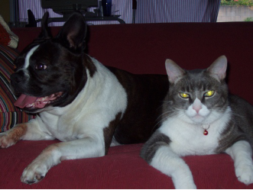
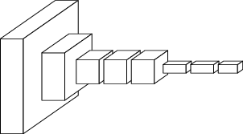
convnets perform classification
< 1 millisecond
“tabby cat”
1000-dim vector
end-to-end learning
Slide credit: Jonathan Long

Slide 5
R-CNN does detection
many seconds
R-CNN
“dog”
“cat”
Slide credit: Jonathan Long

Slide 6
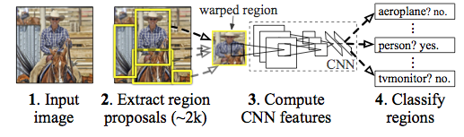
R-CNN
figure: Girshick et al.
Slide credit: Jonathan Long

Slide 7
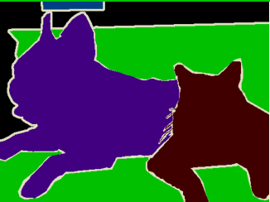
< 1/5 second
???
end-to-end learning
Slide credit: Jonathan Long

Slide 8
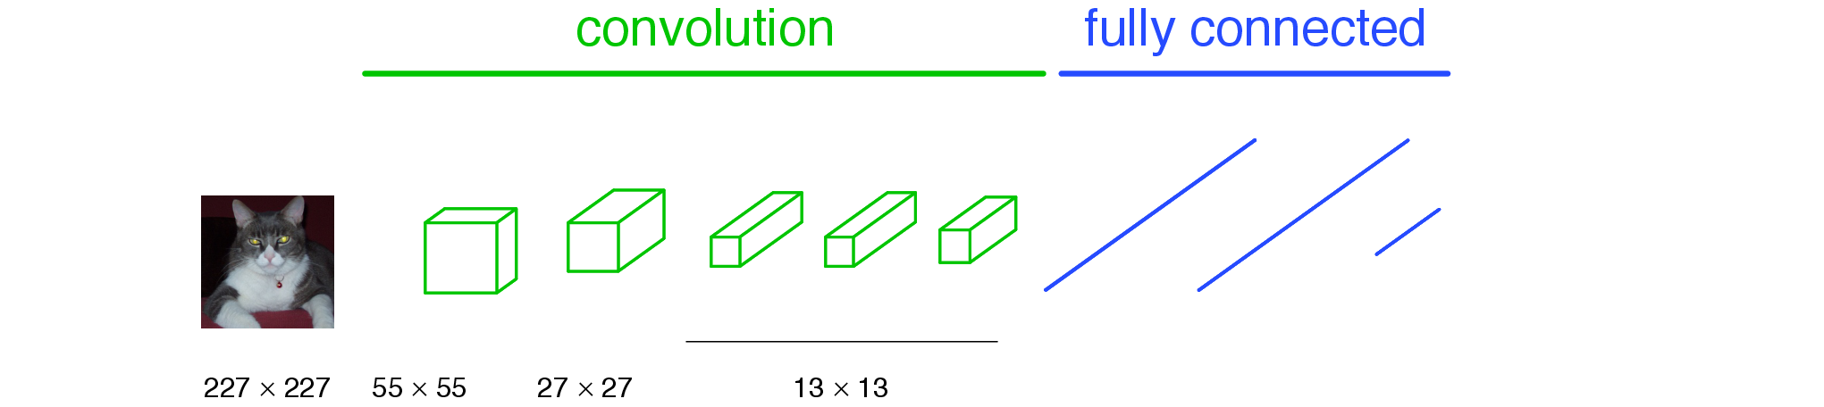
a classification network
“tabby cat”
Slide credit: Jonathan Long
Notes:
note omissions
“activations”
fixed size input, single label output
desire: efficient per-pixel output

Slide 9
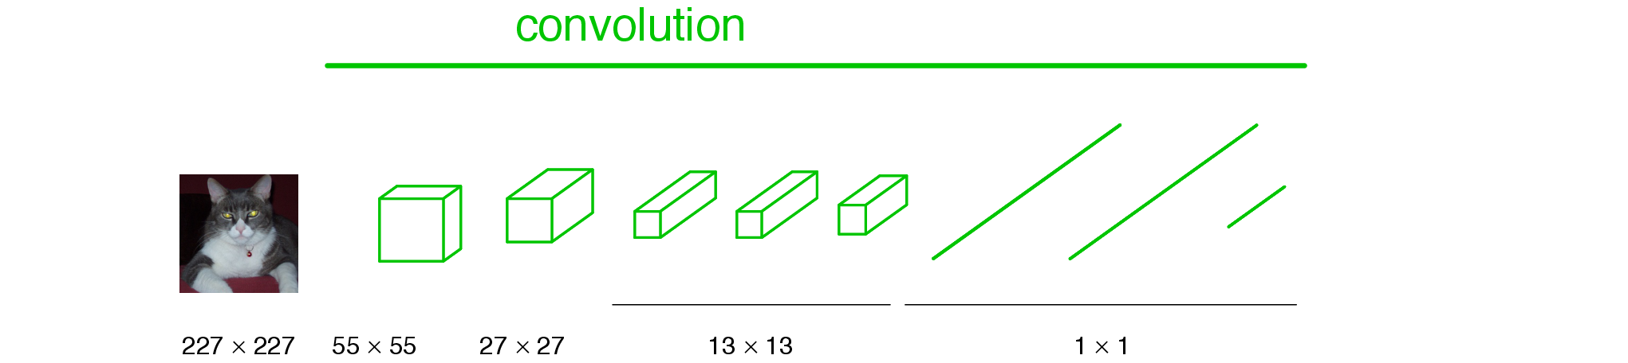
becoming fully convolutional
Slide credit: Jonathan Long

Slide 10
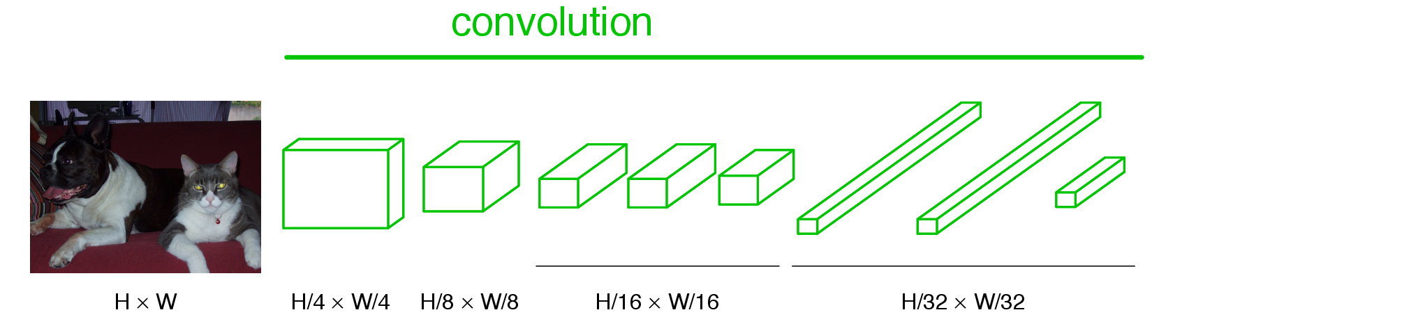
becoming fully convolutional
Slide credit: Jonathan Long

Slide 11
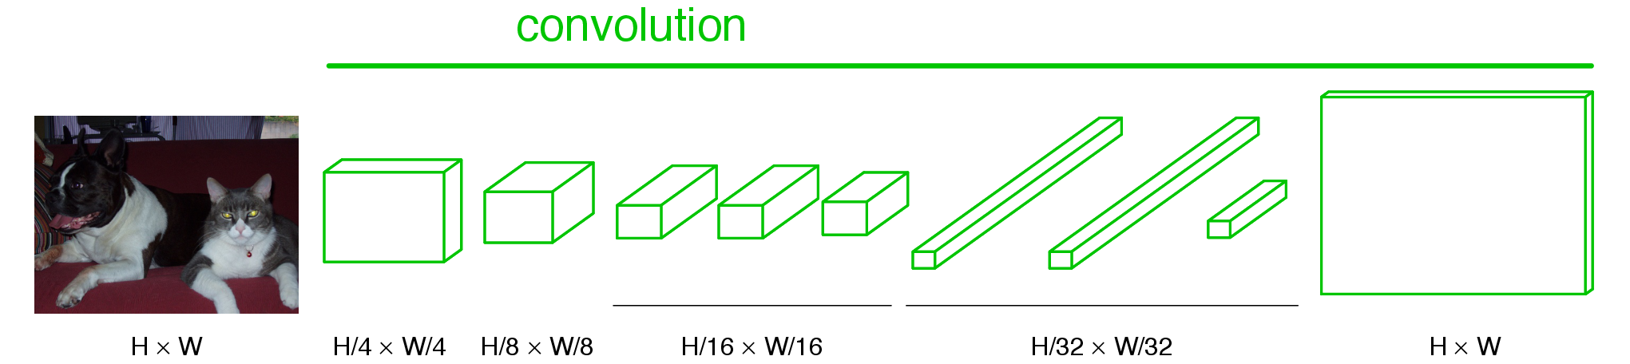
upsampling output
Slide credit: Jonathan Long

Slide 12
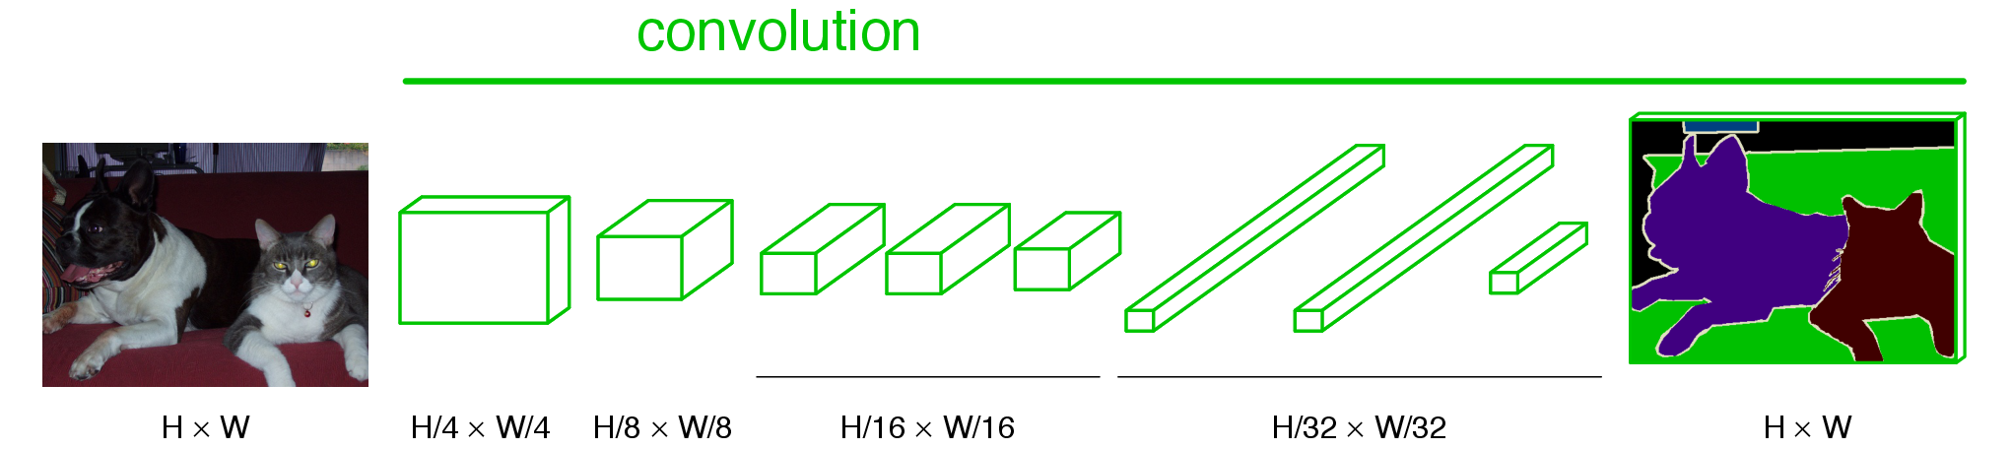
end-to-end, pixels-to-pixels network
upsampling
conv, pool,
nonlinearity
pixelwise
output + loss
Slide credit: Jonathan Long

Slide 13
Dense Predictions
Shift-and-stitch: trick that yields dense predictions without interpolation
Upsampling via deconvolution
Shift-and-stitch used in preliminary experiments, but not included in final model
Upsampling found to be more effective and efficient
Notes:
“Final layer deconvolutional filters are fixed to bilinear inter- polation, while intermediate upsampling layers are initial- ized to bilinear upsampling”
Changing only the filters and layer strides of a convnet can produce the same output as this shift-and-stitch trick.

Slide 14
Classifier to Dense FCN
Convolutionalize proven classification architectures: AlexNet, VGG, and GoogLeNet (reimplementation)
Remove classification layer and convert all fully connected layers to convolutions
Append 1x1 convolution with channel dimensions and predict scores at each of the coarse output locations (21 categories + background for PASCAL)
Notes:
“Despite similar classification accuracy, our implementation of GoogLeNet did not match this segmentation result.”

Slide 15
Classifier to Dense FCN
Cast ILSVRC classifiers into FCNs and compare performance on validation set of PASCAL 2011
Notes:
THESE ARE VAL NUMBERS. Just begun and they are already state of the art
They initialize using the classification models trained on imagenet
Train with per-pixel multinomial loss and validate with mean intersection over union

Slide 16
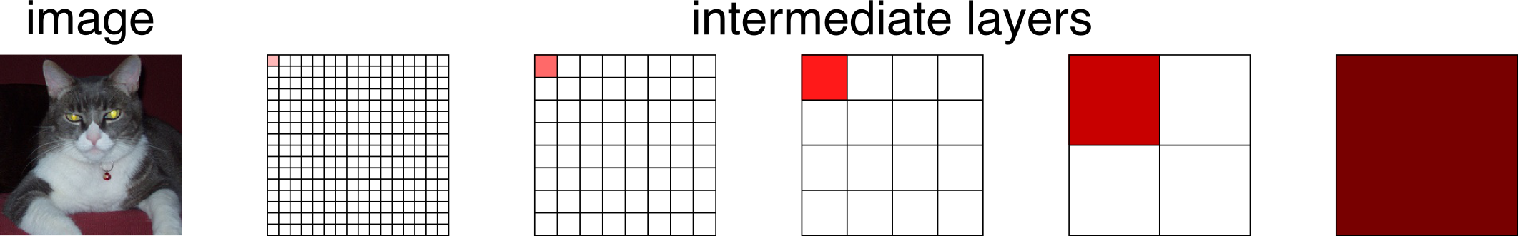
spectrum of deep features
combine where (local, shallow) with what (global, deep)
fuse features into deep jet
(cf. Hariharan et al. CVPR15 “hypercolumn”)
Slide credit: Jonathan Long

Slide 17
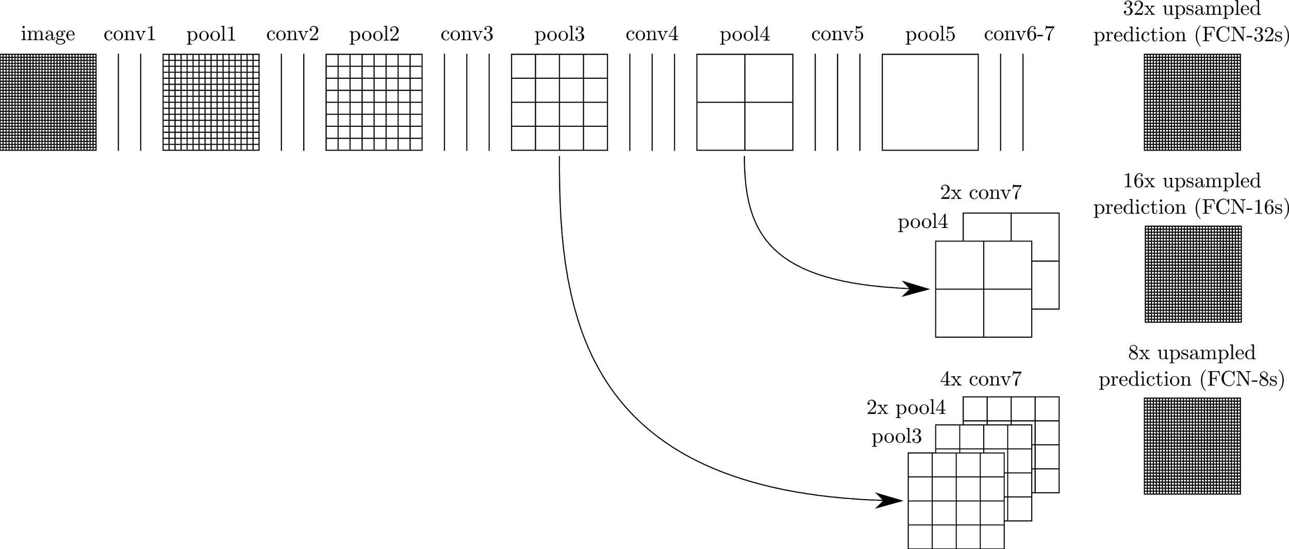
skip layers
interp + sum
skip to fuse layers!
interp + sum
end-to-end, joint learning
of semantics and location
Slide credit: Jonathan Long
dense output

Slide 18
skip layers
Notes:
“Max fusion made learning difficult due to gradient switching.”
Decreasing the stride of pooling layers is the most straightforward way to obtain finer predictions. However, doing so is problematic for our VGG16-based net.
Setting the pool5 layer to have stride 1 requires our convolutionalized fc6 to have a kernel size of 14 × 14 in order to maintain its receptive field size. In addi- tion to their computational cost, we had difficulty learning such large filters. We made an attempt to re-architect the layers above pool5 with smaller filters, but were not suc- cessful in achieving comparable performance; one possible explanation is that the initialization from ImageNet-trained weights in the upper layers is important.

Slide 19
Comparison of skip FCNs
Results on subset of validation set of PASCAL VOC 2011
Notes:
Fixed = only fine tuning in final layer

Slide 20
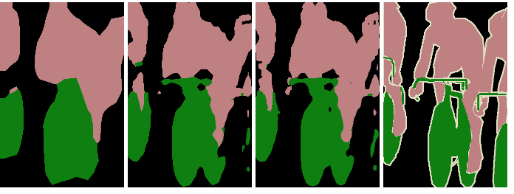
skip layer refinement
input image
stride 32
stride 16
stride 8
ground truth
no skips
1 skip
2 skips
Slide credit: Jonathan Long

Slide 21
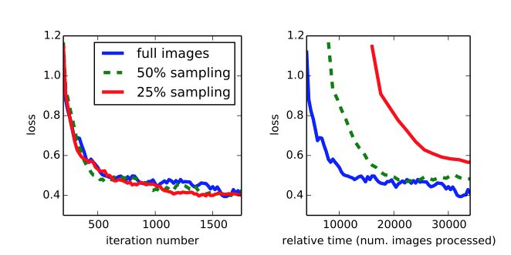
training + testing
train full image at a time without patch sampling
reshape network to take input of any size
forward time is ~150ms for 500 x 500 x 21 output
Slide credit: Jonathan Long

Slide 22
Results – PASCAL VOC 2011/12
VOC 2011: 8498 training images (from additional labeled data
Notes:
For following 3 results, dropout was used when used in original network
SDS: MCG proposals, feature extraction, SVM to classify, region refinement

Slide 23
Results – NYUDv2
1449 RGB-D images with pixelwise labels → 40 categories
Notes:
Gupta: region proposals (using depth and rgb), deep features for depth and rgb, svm classifier, segmentation
Gupta et all encode depth differently (surface normals and height from ground included)
RGBD (early fusion) little improvement, perhaps difficult to propogate meaningful gradients through model
To add depth information, we train on a model upgraded to take four-channel RGB-D input (early fusion)

Slide 24
Results – SIFT Flow
2688 images with pixel labels
→33 semantic categories, 3 geometric categories
Learn both label spaces jointly
→ learning and inference have similar performance and computation as independent models
Notes:
Semantic: bridge, mountain, sun, etc
Geometric: horizontal, vertical, sky
Farabet: multi-scale convnet, averaging class predictions across superpixels
Pinheiro: patch based learning using multiple scales with rcnns

Slide 25
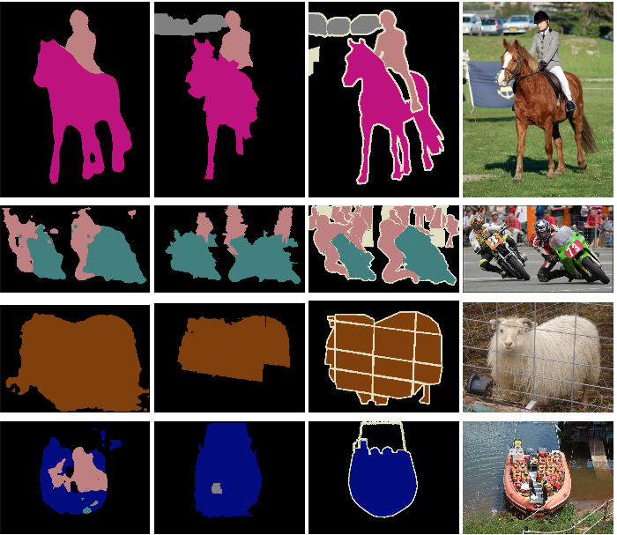
results
FCN
SDS*
Truth
Input
Relative to prior state-of-the-art SDS:
20% relative improvement
for mean IoU
286× faster
*Simultaneous Detection and Segmentation Hariharan et al. ECCV14
Slide credit: Jonathan Long
Notes:
+ NYUD net for multi-modal input and SIFT Flow net for multi-task output

Slide 26
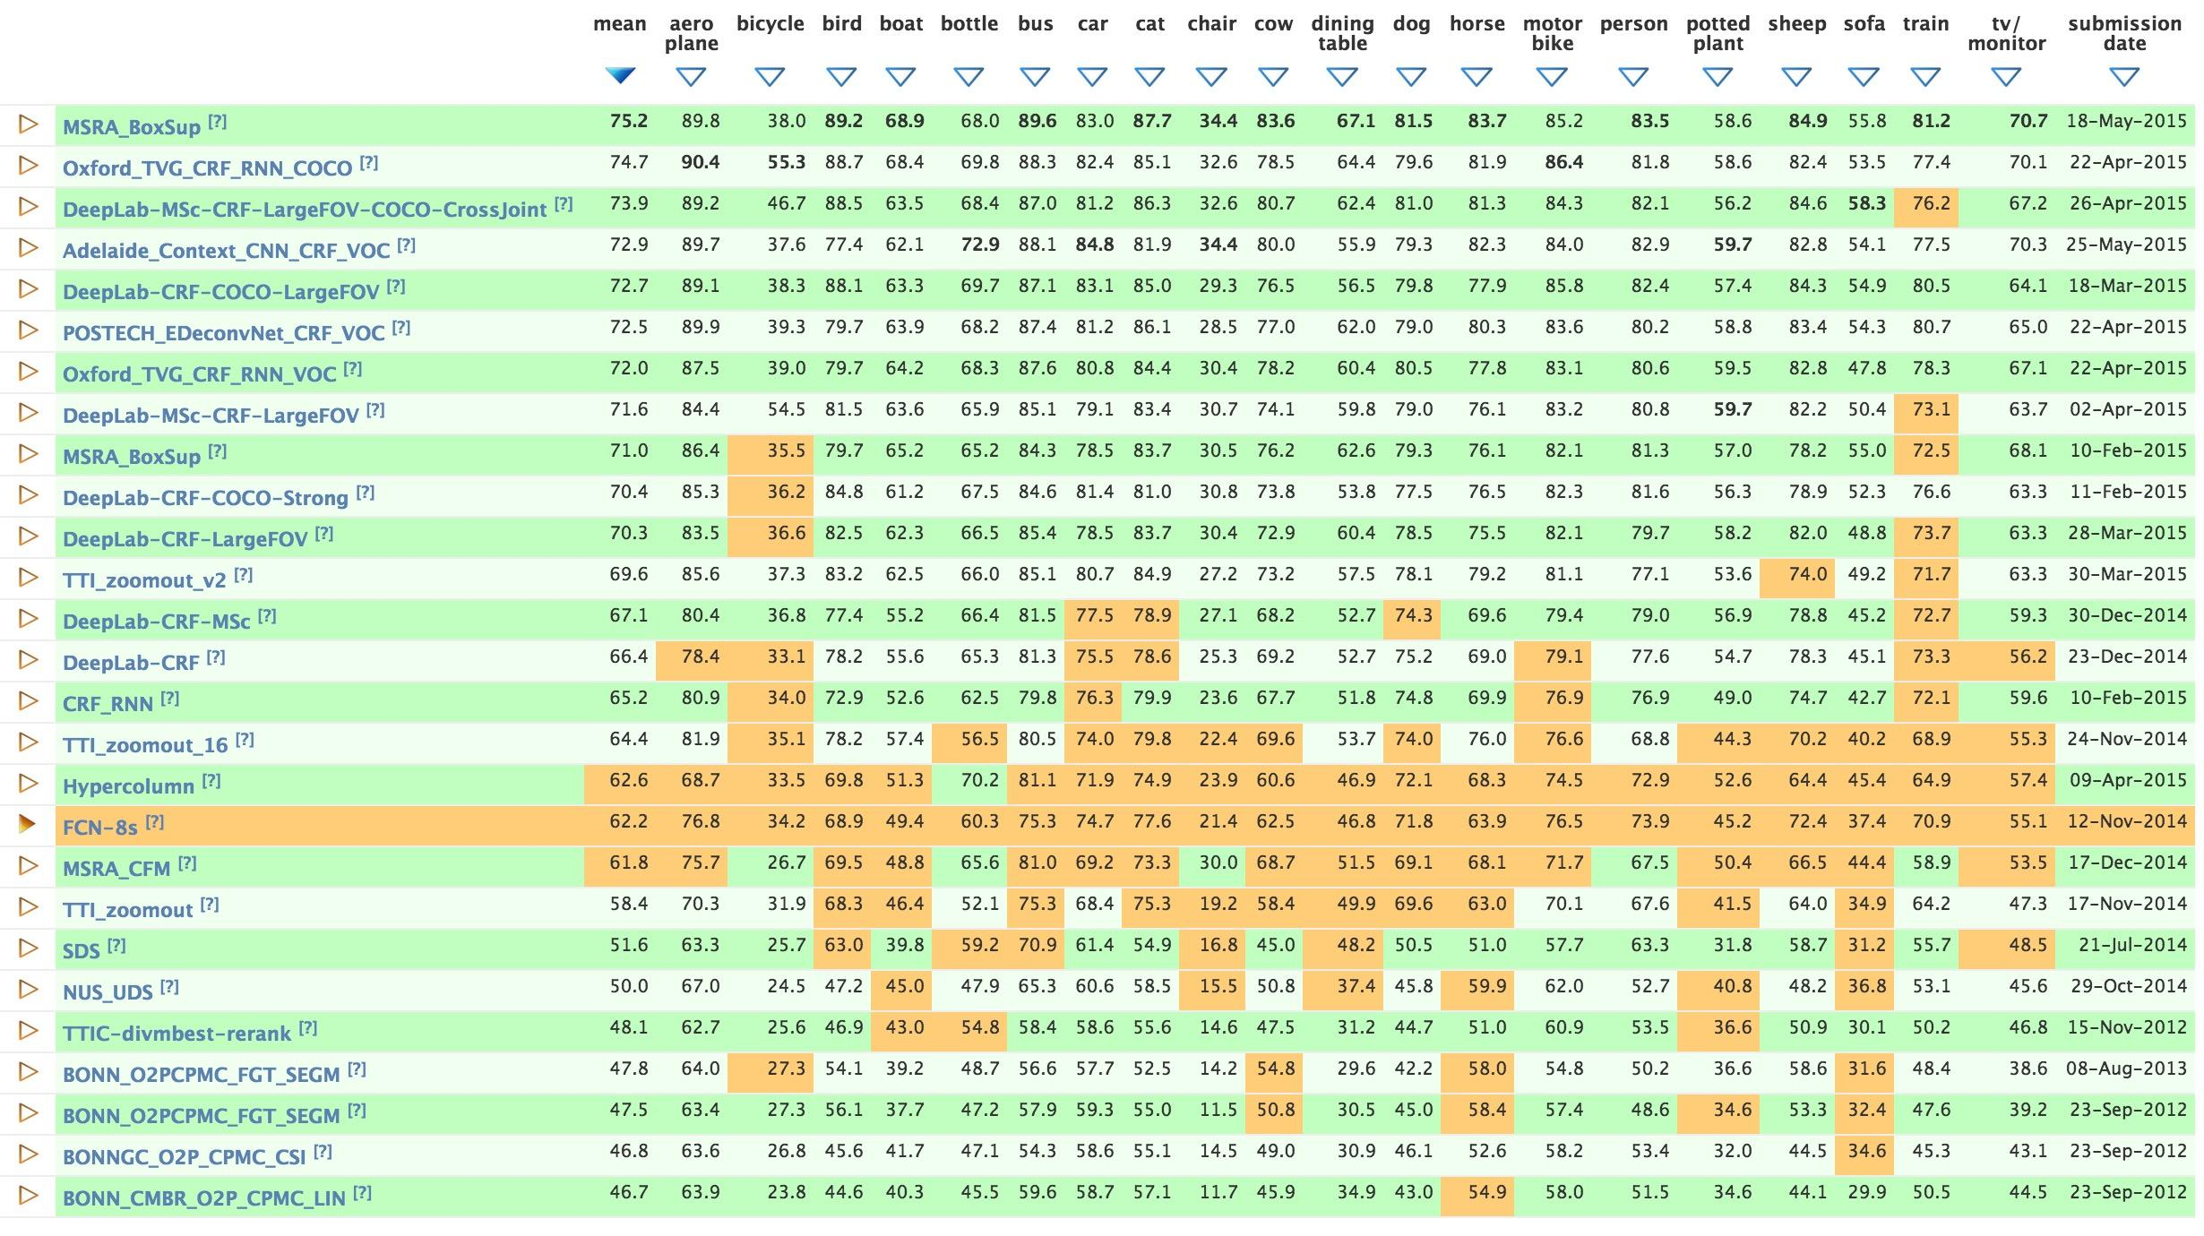
leaderboard
FCN
FCN
FCN
FCN
FCN
FCN
FCN
FCN
FCN
FCN
== segmentation with Caffe
FCN
FCN
FCN
FCN
FCN
Slide credit: Jonathan Long
Notes:
Many segmentation methods powered by Caffe, most FCNs

Slide 27
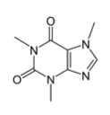

conclusion
fully convolutional networks are fast, end-to-end models for pixelwise problems
code in Caffe branch (merged soon)
models for PASCAL VOC, NYUDv2,
SIFT Flow, PASCAL-Context
caffe.berkeleyvision.org
fcn.berkeleyvision.org
github.com/BVLC/caffe
Slide credit: Jonathan Long

