Slide 1
Object Detection using CNNs
Viresh Ranjan, Ardalan Khosrowpour

Slide 2
Image classification (mostly what you’ve seen so far)
𝐾 classes
Task: Assign the correct class label to the whole image
Digit classification (MNIST)
Object recognition (Caltech-101, ImageNet, etc.)
Slide Credit: Ross Girshick

Slide 3
Classification Detection
Dog
Bridge
Bridge
Dog
Dog
Easyish, these days
Still quite a lot harder
Slide Credit: Ross Girshick

Slide 4
Problem formulation
The Visual World ≈ 𝐾 object classes
{airplane, bird, motorbike,
person,
sofa, bg}
Person 0.7
YODA:
Yet another Object Detection Algorithm
Motorbike 0.9
Input
Desired output
*Actual results may vary
Slide Credit: Ross Girshick

Slide 5
Challenges in using CNNs for detection
Data scarcity.
Deep CNNs => Large receptive field => Poor localization.

Slide 6
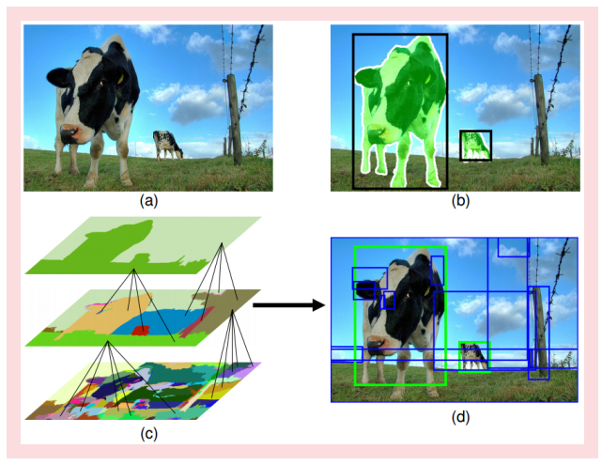
Object Proposal/Region Proposal
Image Credit: Piotr Dollar

Slide 7
Rich Feature Hierarchies for Accurate Object Detection and Semantic Segmentation
Ross Girshick, Jeff Donahue, Trevor Darrell, Jitendra Malik

Slide 8
PASCAL VOC detection history
70
60
50
41%
41%
40
37%
(%)
DPM++, MKL,
Selective Search,
28%
DPM++
mAP
30
Selective Search
DPM++, MKL
Top competition results (2007 -
2012)
23%
DPM, MKL
20
17%
DPM,
DPM
HOG+BOW
10
0
VOC’07
VOC’08 VOC’09 VOC’10 VOC’11
PASCAL VOC challenge dataset
VOC’12
PASCAL VOC challenge dataset
[Source: http://pascallin.ecs.soton.ac.uk/challenges/VOC/voc20{07,08,09,10,11,12}/results/index.html]

Slide 9
A rapid rise in performance
70
60
50
41%
41%
40
37%
(%)
DPM++, MKL,
Selective Search,
28%
DPM++
mAP
30
Selective Search
DPM++, MKL
Top competition results (2007 -
2012)
23%
DPM, MKL
20
17%
DPM,
DPM
HOG+BOW
10
0
VOC’07
VOC’08 VOC’09 VOC’10 VOC’11
PASCAL VOC challenge dataset
VOC’12
PASCAL VOC challenge dataset
[Source: http://pascallin.ecs.soton.ac.uk/challenges/VOC/voc20{07,08,09,10,11,12}/results/index.html]

Slide 10
Complexity and the plateau
70
60
plateau & increasing complexity
50
41% 41%
40
37%
(%)
DPM++, MKL,
Selective Search,
28%
DPM++
mAP
30
Selective Search
DPM++, MKL
Top competition results (2007 -
2012)
23%
DPM, MKL
20
17%
DPM,
DPM
HOG+BOW
10
0
VOC’07
VOC’08 VOC’09 VOC’10 VOC’11
PASCAL VOC challenge dataset
VOC’12
PASCAL VOC challenge dataset
[Source: http://pascallin.ecs.soton.ac.uk/challenges/VOC/voc20{07,08,09,10,11,12}/results/index.html]

Slide 11
SIFT, HOG, LBP, ...
70
60
Post- competition results (2013 - present)
50
SegDPM (2013)
40
Regionlets
Regionlets (2013)
DPM++
DPM++, MKL,
Selective Search,
(%)
(2013)
mAP
30
Selective Search
DPM++, MKL
Top competition results (2007 -
2012)
DPM, MKL
20
DPM,
DPM
HOG+BOW
10
0
VOC’07
VOC’08 VOC’09 VOC’10 VOC’11
PASCAL VOC challenge dataset
VOC’12
PASCAL VOC challenge dataset
[Regionlets. Wang et al. ICCV’13] [SegDPM. Fidler et al. CVPR’13]

Slide 12
R-CNN: Regions with CNN features
70
R-CNN 58.5%
R-CNN
R-CNN
60
53.7%
53.3%
Post- competition results (2013 - present)
50
40
(%)
mAP
30
Top competition results (2007 -
2012)
20
10
0
VOC’07
VOC’08 VOC’09 VOC’10 VOC’11
PASCAL VOC challenge dataset
VOC’12
PASCAL VOC challenge dataset

Slide 13
Feature learning with CNNs
Fukushima 1980
Neocognitron
Rumelhart, Hinton, Williams 1986
“T” versus “C” problem
INPUT 32x32
C1: feature maps 6@28x28
C3: f. maps 16@10x10
S4: f. maps 16@5x5
LeCun et al. 1989-1998
Handwritten digit reading / OCR
S2: f. maps
C5: layer
F6: layer OUTPUT
84 10
6@14x14
120
Subsampling..C.onvolutions
Convolutions
Subsampling
Full connection
Full connection
Gaussian
Krizhevksy, Sutskever, Hinton 2012
ImageNet classification breakthrough “SuperVision” CNN

Slide 14
CNNs for object detection
Vaillant, Monrocq, LeCun 1994
Multi-scale face detection
LeCun, Huang, Bottou 2004
NORB dataset
Cireşan et al. 2013
Mitosis detection
Sermanet et al. 2013
Pedestrian detection
Szegedy, Toshev, Erhan 2013
PASCAL detection (VOC’07 mAP 30.5%)
...
DBN
mask regression layer
...
full object mask
left object mask

Slide 15
Can we break through the PASCAL plateau with feature learning?

Slide 16
R-CNN: Regions with CNN features
aeroplane? no.
.
CNN
.
person? yes.
.
.
tvmonitor? no.
Input image
Extract region proposals (~2k / image)
Compute CNN features
Classify regions (linear SVM)

Slide 17
R-CNN at test time: Step 1
aeroplane? no.
.
CNN
.
person? yes.
.
.
tvmonitor? no.
Input image
Extract region proposals (~2k / image)
Proposal-method agnostic, many choices
Selective Search [van de Sande, Uijlings et al.]
Objectness [Alexe et al.]
(Used in this work)
Category independent object proposals [Endres & Hoiem]
CPMC [Carreira & Sminchisescu]
Active area, at this CVPR
BING [Ming et al.] – fast
MCG [Arbelaez et al.] – high-quality segmentation

Slide 18
R-CNN at test time: Step 2
aeroplane? no.
.
CNN
.
person? yes.
.
.
tvmonitor? no.
Input image
Extract region proposals (~2k / image)
Compute CNN features

Slide 19
R-CNN at test time: Step 2
aeroplane? no.
.
CNN
.
person? yes.
.
.
tvmonitor? no.
Input image
Extract region proposals (~2k / image)
Compute CNN features
Dilate proposal

Slide 20
R-CNN at test time: Step 2
aeroplane? no.
.
CNN
.
person? yes.
.
.
tvmonitor? no.
Input image
Extract region proposals (~2k / image)
Compute CNN features
a. Crop

Slide 21
R-CNN at test time: Step 2
aeroplane? no.
.
CNN
.
person? yes.
.
.
tvmonitor? no.
Input image
Extract region proposals (~2k / image)
Compute CNN features
227 x 227
a. Crop
b. Scale (anisotropic)

Slide 22
R-CNN at test time: Step 2
aeroplane? no.
.
CNN
.
person? yes.
.
.
tvmonitor? no.
Input image
Extract region proposals (~2k / image)
Compute CNN features
c. Forward propagate Output: “fc7” features
. Crop
b. Scale (anisotropic)

Slide 23
R-CNN at test time: Step 3
aeroplane? no.
.
CNN
.
person? yes.
.
.
tvmonitor? no.
Input image
Extract region proposals (~2k / image)
Compute CNN features
Classify regions
person? 1.6
...
horse? -0.3
...
4096-dimensional fc7 feature vector
linear classifiers (SVM or softmax)
proposal

Slide 24
Step 4: Object proposal refinement
Linear regression
on CNN features
Original proposal
Predicted object bounding box
Bounding-box regression

Slide 25
R-CNN results on PASCAL
 | VOC 2007 | VOC 2010
DPM v5 (Girshick et al. 2011) | 33.7% | 29.6%
UVA sel. search (Uijlings et al. 2013) |  | 35.1%
Regionlets (Wang et al. 2013) | 41.7% | 39.7%
SegDPM (Fidler et al. 2013) |  | 40.4%
R-CNN 54.2% 50.2%
R-CNN + bbox regression 58.5% 53.7%
Reference systems
metric: mean average precision (higher is better)

Slide 26
R-CNN results on PASCAL
 | VOC 2007 | VOC 2010
DPM v5 (Girshick et al. 2011) | 33.7% | 29.6%
UVA sel. search (Uijlings et al. 2013) |  | 35.1%
Regionlets (Wang et al. 2013) | 41.7% | 39.7%
SegDPM (Fidler et al. 2013) |  | 40.4%
R-CNN | 54.2% | 50.2%
R-CNN + bbox regression | 58.5% | 53.7%
metric: mean average precision (higher is better)

Slide 27
ImageNet detection
New challenge introduced in 2013 PASCAL-like image complexity 200 object categories

Slide 28
R-CNN and OverFeat
R-CNN
developed using PASCAL VOC
tested on PASCAL VOC: s-o-t-a
no results on ILSVRC 2013 (until now)
OverFeat [Sermanet et al. 2014]
developed using ILSVRC 2013
tested on ILSVRC 2013: s-o-t-a
no results on PASCAL VOC
No apples-to-apples comparison

Slide 29
R-CNN on ImageNet detection
ILSVRC2013 detection test set mAP
*R−CNN BB
31.4%
*OverFeat (2)
24.3%
UvA−Euvision
22.6%
*NEC−MU
20.9%
*OverFeat (1)
19.4%
Toronto A
11.5%
SYSU_Vision
10.5%
GPU_UCLA
9.8%
Delta
6.1%
post competition result competition result
UIUC−IFP
1.0%
0
20 40 60 80
mean average precision (mAP) in %
100
Get the R-CNN arXiv Tech Report at http://bit.ly/rcnn-tr

Slide 30
Detection speed & scalability
0.005s
20 classes
2.1s
cpu
2.6s
cpu
5.9s
gpu
0.001s
cpu
0.026s
200 classes
2.1s
2.6s
5.9s
0.012s
0s
2.5s
Selective search
5s
7.5s
10s
12.5s
O(1)
Cropping & resizing
CNN feature computation (GPU)
N = # classes
Region classification NMS
O(N)
Hardware: Intel Core i7-3930K 3.2Ghz and NVIDIA Tesla K20c We thank NVIDIA for generous hardware donations.

Slide 31
Detection speed & scalability
0.005s
20 classes
2.1s
cpu
2.6s
cpu
5.9s
gpu
0.001s
cpu
0.026s
200 classes
2.1s
2.6s
5.9s
0.012s
0s
2.5s
Selective search
5s
7.5s
10s
12.5s
O(1)
Cropping & resizing
CNN feature computation (GPU)
30ms!
Region classification NMS
O(N)
Hardware: Intel Core i7-3930K 3.2Ghz and NVIDIA Tesla K20c We thank NVIDIA for generous hardware donations.

Slide 32
False positive analysis
R−CNN fc6: animals
R−CNN FT fc7: animals
R−CNN FT fc7 BB: animals
100
100
100
percentage of each type
80
80
80
60
60
60
40
Loc Sim Oth BG
40
Loc Sim Oth BG
40
Loc Sim Oth BG
20
20
20
0
0
0
25 100 400 1600
6400 25
100 400 1600
total false positives
6400 25
100 400 1600
total false positives
6400
total false positives
No fine-tuning
Analysis software: D. Hoiem, Y. Chodpathumwan, and
Q. Dai. “Diagnosing Error in Object Detectors.” ECCV, 2012.

Slide 33
False positive analysis
R−CNN fc6: animals
R−CNN FT fc7: animals
R−CNN FT fc7 BB: animals
100
100
100
percentage of each type
80
80
80
60
60
60
40
Loc Sim Oth BG
40
Loc Sim Oth BG
40
Loc Sim Oth BG
20
20
20
0
0
0
25 100 400 1600
6400 25
100 400 1600
total false positives
6400 25
100 400 1600
total false positives
6400
total false positives
After fine-tuning

Slide 34
False positive analysis
R−CNN fc6: animals
R−CNN FT fc7: animals
R−CNN FT fc7 BB: animals
100
100
100
percentage of each type
80
80
80
60
60
60
40
Loc Sim Oth BG
40
Loc Sim Oth BG
40
Loc Sim Oth BG
20
20
20
0
0
0
25 100 400 1600
6400 25
100 400 1600
total false positives
6400 25
100 400 1600
total false positives
6400
total false positives
After bounding- box regression

Slide 35
Top bicycle FPs (AP = 72.8%)
bicycle (loc): ov=0.41 1−r=0.64
bicycle (loc): ov=0.35 1−r=0.61
bicycle (loc): ov=0.15 1−r=0.59
bicycle (loc): ov=0.44 1−r=0.57
bicycle (sim): ov=0.00 1−r=0.56
bicycle (bg): ov=0.00 1−r=0.52
bicycle (loc): ov=0.55 1−r=0.47
bicycle (bg): ov=0.00 1−r=0.47
icycle (loc): ov=0.46 1−r=0.45
bicycle (loc): ov=0.10 1−r=0.45
bicycle (loc): ov=0.42 1−r=0.45
bicycle (bg): ov=0.00 1−r=0.44

Slide 36
False positive #15
bicycle (bg): ov=0.00 1−r=0.44

Slide 37
False positive #15
(zoom)
bicycle (bg): ov=0.00 1−r=0.44
Unannotated bicycle

Slide 38
False positive #15
1949 French comedy by Jacques Tati

Slide 39
Training R-CNN
Bounding-box labeled detection data is scarce
Key insight:
Use supervised pre-training on a data-rich auxiliary task and transfer to detection

Slide 40
R-CNN training: Step 1
Supervised pre-training
Train a SuperVision CNN* for the 1000-way ILSVRC image classification task
Auxiliary task:
ILSVRC 2012 classification
(1.2 million images)
Train CNN
*Network from Krizhevsky, Sutskever & Hinton. NIPS 2012 Also called “AlexNet”

Slide 41
R-CNN training: Step 2
Fine-tune the CNN for detection Transfer the representation learned for ILSVRC
classification to PASCAL (or ImageNet detection)
Fine-tune CNN
Target task:
PASCAL VOC detection (~25k object labels)

Slide 42
R-CNN training: Step 2
Fine-tune the CNN for detection Transfer the representation learned for ILSVRC
classification to PASCAL (or ImageNet detection)
Fine-tune CNN
Target task:
PASCAL VOC detection (~25k object labels)
Try Caffe! http://caffe.berkeleyvision.org
Clean & fast CNN library in C++ with Python and MATLAB interfaces
Used by R-CNN for training, fine-tuning, and feature computation

Slide 43
R-CNN training: Step 3
Train detection SVMs
(With the softmax classifier from fine-tuning mAP decreases from 54% to 51%)
object proposals PASCAL VOC
~ 2k windows / image
CNN features
per-class SVM
training labels

Slide 44
What did the network learn?

Slide 45
What did the network learn?
“stimulus”
← feature channels →
6
y
6
x
256
pool5 feature map

Slide 46
What did the network learn?
“stimulus”
← feature channels →
6 cells
227 pixels
6
y
y
6
227
6
x
256
pool5 feature map
x
feature position receptive field
Visualize images that activate pool5 a feature

Slide 47
0.8
0.8
0.8
0.7
0.7
0.7
0.7
0.7
0.6
0.6
0.6
0.6
0.6
0.6
0.6
0.6
0.6
0.5
0.5
0.5
0.5
0.5
0.5
0.5
0.5
0.5
0.5
0.5
0.5
0.5
0.5
0.5
0.4
0.4
0.4
0.4
0.4
0.4
0.4
0.4
0.4
0.4
0.4
0.4
0.4
0.4
0.4
0.4

Slide 48
0.9
0.9
0.8
0.8
0.8
0.8
0.8
0.8
0.8
0.8
0.8
0.7
0.7
0.7
0.7
0.7
0.7
0.7
0.7
0.7
0.7
0.7
0.7
0.7
0.7
0.7
0.7
0.7
0.7
0.7
0.7
0.7
0.7
0.7
0.7
0.7
0.7
0.7
0.7
0.7
0.7
0.7
0.7
0.7
0.7
0.7
0.7
0.7

Slide 49
0.9
0.8
0.8
0.7
0.7
0.7
0.7
0.7
0.6
0.6
0.6
0.6
0.6
0.6
0.6
0.6
0.6
0.6
0.6
0.6
0.6
0.6
0.6
0.6
0.6
0.6
0.6
0.6
0.5
0.5
0.5
0.5
0.5
0.5
0.5
0.5
0.5
0.5
0.5
0.5
0.5
0.5
0.5
0.5
0.5
0.5
0.5
0.5

Slide 50
0.8
0.8
0.8
0.7
0.7
0.7
0.7
0.6
0.6
0.6
0.6
0.6
0.6
0.6
0.6
0.6
0.6
0.6
0.5
0.5
0.5
0.5
0.5
0.5
0.5
0.5
0.5
0.5
0.5
0.5
0.5
0.5
0.5
0.5
0.5
0.5
0.5
0.5
0.5
0.5
0.5
0.5
0.5
0.5
0.5
0.5
0.5
0.5

Slide 51
0.9
0.8
0.8
0.8
0.8
0.8
0.7
0.7
0.7
0.7
0.7
0.7
0.7
0.7
0.7
0.7
0.7
0.7
0.7
0.7
0.7
0.7
0.7
0.6
0.6
0.6
0.6
0.6
0.6
0.6
0.6
0.6
0.6
0.6
0.6
0.6
0.6
0.6
0.6
0.6
0.6
0.6
0.6
0.6
0.6
0.6
0.6
0.6

Slide 52
Semantic segmentation
CPMC segments
(Carreira & Sminchisescu)
full
fg

Slide 53
Semantic segmentation
CPMC segments
(Carreira & Sminchisescu)
full
fg
 | VOC 2011 test
Bonn second-order pooling (Carreira et al.) | 47.6%
R-CNN fc6 full+fg (no fine-tuning) | 47.9%
Improved to 50.5% in our upcoming ECCV’14 work: Simultaneous Localization and Detection. Hariharan et al.

Slide 54
Take away
Dramatically better PASCAL mAP
R-CNN outperforms other CNN-based methods on ImageNet detection
Detection speed is manageable (~11s / image)
Scales very well with number of categories (30ms for 20 → 200 classes!)
R-CNN is simple and completely open source

Slide 55
Fast R-CNN

Slide 56
PASCAL VOC object detection
After
Before the successful application of ConvNets
70%
mean Average Precision (mAP)
60%
< 2 years 1.8x mAP
50%
40%
30%
~5 years
20%
10%
0%
2006
2007
2008
2009
2010
2011
2012
2013
2014
2015
year
Precision: higher is better
Slide Credit: Ross Girshick

Slide 57
Quick background
Region-based Convolution Networks (R-CNNs)
Input image
Extract region proposals (~2k / image) e.g., selective search
[van de Sande, Uijlings et al.]
Compute CNN features on regions
Classify and refine regions
[Girshick et al. CVPR’14]

Slide 58
Issues with R-CNNs
Training
Multi-stage
Fine-tuning
Training SVMs
Bounding-Box regression
Each object proposal processed separately
2.5 GPU days
Large storage requirement
Testing
Detection with VGG16 takes 47s / image.

Slide 59
Fast R-CNN
Outputs:
bbox
Deep ConvNet
softmax regressor
FC FC
RoI pooling
layer
FCs
RoI projection
conv5
RoI feature
feature map
vector
For each RoI
Slide Credit: Ross Girshick

Slide 60
Conv

Slide 61
Conv

Slide 62
Conv
ROI Pooling

Slide 63
Fast R-CNN
Outputs:
bbox
Deep ConvNet
softmax regressor
FC FC
RoI pooling
layer
FCs
RoI projection
conv5
RoI feature
feature map
vector
For each RoI
Slide Credit: Ross Girshick

Slide 64
The train-time net (multi-task losses)
Classification loss
Bounding-box regression loss
Slide Credit: Ross Girshick

Slide 65
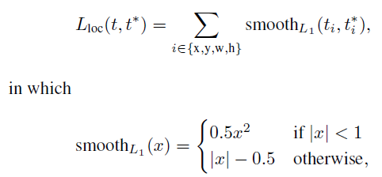
The train-time net (multi-task losses)

Slide 66
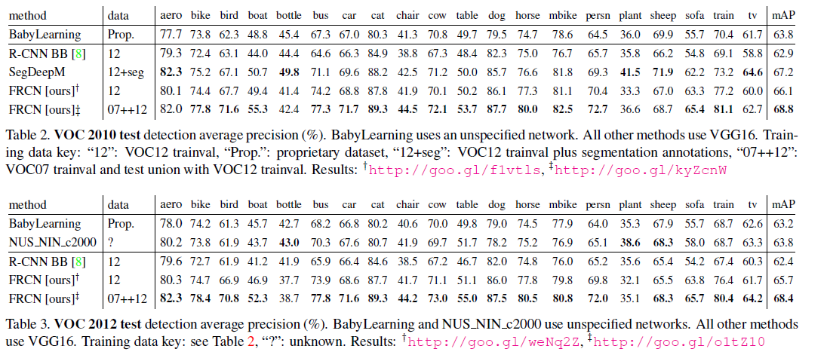
Results

Slide 67
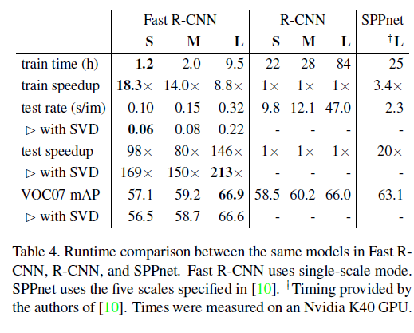
Results

Slide 68
Results

Slide 69
Faster R-CNN
Shaoqing Ren, Kaiming He, Ross Girshick, Jian Sun. Microsoft Research
The detection network also proposes objects
Marginal cost of proposals: 10ms
Higher mAP, faster
Open-source Caffe code coming later this summer
Region Proposal Network shares conv layers with Fast R-CNN object detection network
Slide Credit: Ross Girshick

