Slide 1
Robustness to Adversarial Examples
Presenters: Pooja Harekoppa, Daniel Friedman

Slide 2
Explaining and Harnessing Adversarial Examples
Ian J. Goodfellow, Jonathon Shlens and Christian Szegedy
Google Inc., Mountain View, CA

Slide 3
Highlights
Adversarial examples: speculative explanations
Flaws in the linear nature of models
Fast gradient sign method
Adversarial training of deep networks
Why adversarial examples generalize?
Alternate Hypothesis

Slide 4
Introduction
Szegedy et al. (2014b) : Vulnerability of machine learning models to adversarial examples
A wide variety of models with different architectures trained on different subsets of the training data misclassify the same adversarial example – fundamental blind spots in training algorithms?
Speculative explanations:
  Extreme non linearity
  Insufficient model averaging and insufficient regularization
Linear behavior - real culprit!

Slide 5




Linear explanation of adversarial examples

Slide 6
Linear explanation of adversarial examples
Activations grow linearly!

Slide 7
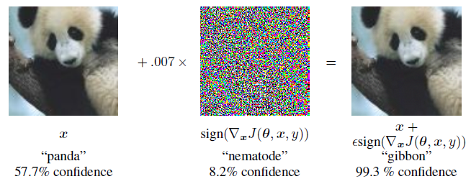
Linear perturbation of non-linear models
ReLUs, maxout networks etc. - easier to optimize linear networks
“Fast gradient sign method”
Image from reference paper

Slide 8
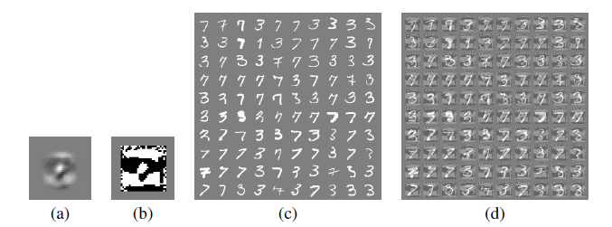
Fast gradient sign – logistic regression
1.6% error rate 99% error rate
Image from reference paper

Slide 9
Adversarial training of deep networks
Deep networks are vulnerable to adversarial examples - Misguided assumption
How to overcome this?
  Training with an adversarial objective function based on the fast gradient sign method
  Error rate reduced from 0.94% to 0.84%

Slide 10

Different kinds of model capacity
Low capacity – unable to make many different confident predictions?
  Incorrect. RBF can.
  RBF networks are naturally immune to adversarial examples – low confidence when they are fooled
RBF network
  Shallow RBF network with no hidden layer: Error rate of 55.4% on MNIST
  Confidence on mistaken examples is only 1.2%
  Drawback: Not invariant to any significant transformations so they cannot generalize very well

Slide 11
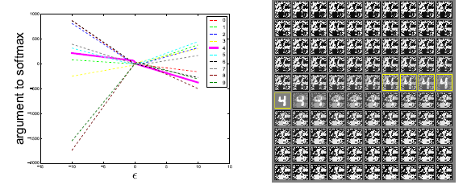
Why do adversarial examples generalize?
Image from reference paper

Slide 12
Alternate Hypothesis
Generative training
  MP-DBM: ϵ of 0.25, error rate of 97.5% on adversarial examples generated from the MNIST
  Being generative alone is not sufficient
Ensemble training
  Ensemble of 12 maxout networks on MNIST: ϵ of 0.25, 91.1% error on adversarial examples on MNIST
  One member of the ensemble: 87.9% error

Slide 13
Summary
Adversarial examples are a result of models being too linear
Generalization of adversarial examples across different models occurs as a result of adversarial perturbations being highly aligned with the weight vector
The direction of perturbation rather than space matters the most
Introduces fast methods of generating adversarial examples
Adversarial training can result in regularization
Models easy to optimize are easy to perturb

Slide 14
Summary
Linear models lack the capacity to resist adversarial perturbation; only structures with a hidden layer can
RBF networks are resistant to adversarial examples
Models trained to model the input distribution are not resistant to adversarial examples.
Ensembles are not resistant to adversarial examples

Slide 15
Robustness and Regularization of Support Vector Machines
H. Xu, C. Caramanis, S. Mannor
McGill University, UT Austin

Slide 16
Key Results
The standard norm-regularized SVM classifier is the solution to a robust classification setup
Norm-based regularization builds in a robustness to certain types of sample noise
These results hold for kernelized SVMs if we have a certain bound

Slide 17
Atomic Uncertainty Set

Slide 18
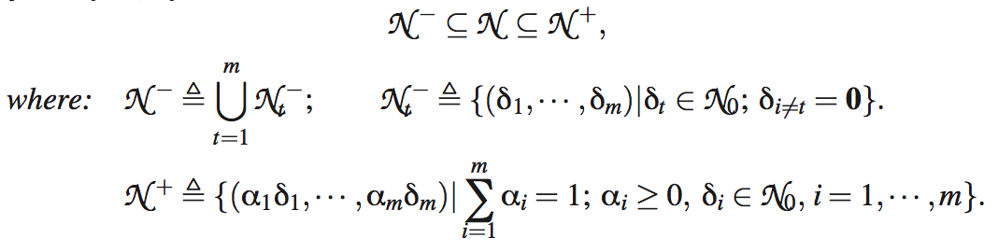
Sublinear Aggregated Uncertainty Set

Slide 19
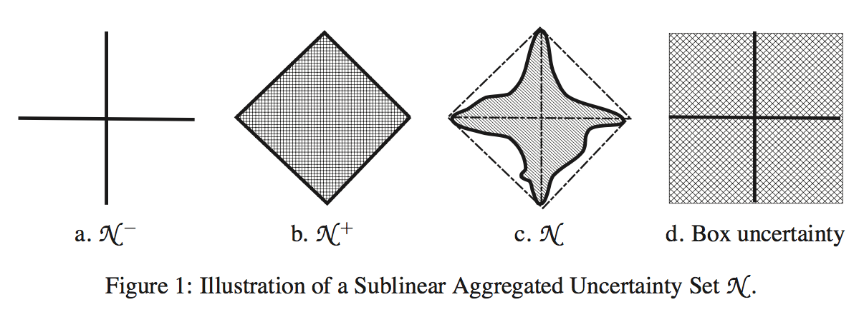
Image from reference paper

Slide 20
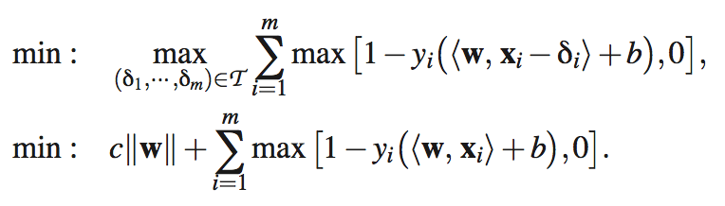
The Main Result

Slide 21
Kernelization
If we have so f non-decreasing with the following:
If x and x’ fall within rho of each other, then

Slide 22
Further Work
Performance gains possible when noise does not have such characteristics

Slide 23
Towards Deep Neural Network Architectures Robust to Adversarial Examples
Shixiang Gu and Luca Rigazio
Panasonic Silicon Valley Laboratory, Panasonic R&D Company of America

Slide 24
Highlights
Pre-processing and training strategies to improve the robustness of DNNs
Corrupting with additional noise and preprocessing with Denoising Autoencoders (DAEs)
  Stacking with DNN makes the network even more weak to adversarial examples
  Neural network’s sensitivity to adversarial examples is more related to intrinsic deficiencies in the training procedure and objective function than to model topology
The crux of the problem is then to come up with an appropriate training procedure and objective function
  Deep Contractive Network (DCN)

Slide 25
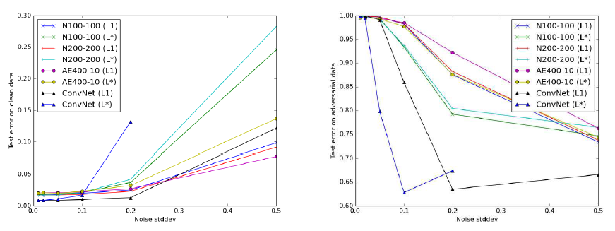
Noise Injection – Gaussian Additive Noise
Plot from reference paper

Slide 26
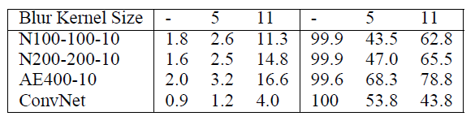
Noise Injection – Gaussian Blurring
Table from reference paper

Slide 27
Conclusion
Neither Gaussian additive noises or blurring is effective in removing enough noise such that its error on adversarial examples could match that of the error on clean data.

Slide 28


Deep Contractive Network
Contractive autoencoder (CAE)
  A variant of AE with additional penalty for minimizing the squared norm of the Jacobian of the hidden representation with respect to input data

Slide 29


Deep Contractive Networks
DCN is a generalization of the contractive autoencoder (CAE) to a feed-forward neural network

Slide 30
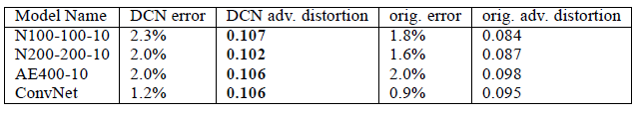
Results
Table from reference paper

Slide 31
Discussions and Future work
DCNs can
  Successfully be trained to propagate contractivity around the input data through the deep architecture without significant loss in final accuracies
Future work
  Evaluate the performance loss due to layer-wise penalties
  Exploring non-Euclidean adversarial examples

Slide 32
Generative Adversarial Nets
Goodfellow et al.
Department d’informatique et recherche operationnelle,
Universite de Montreal

Slide 33
Summary
A generative model is pitter against an adversary: a discriminative model that learns to determine whether a sample is from the model distribution or the data distribution.
Generative model=team of counterfeiters and discriminative model=police

Slide 34
Description
G, the generative model, is a multilayer perceptron with some prior input noise with tunable parameter θ_{g}
D, the discriminative model, is a multilayer perceptron that represents the probability of some x coming from the data distribution rather than the generative model.

Slide 35
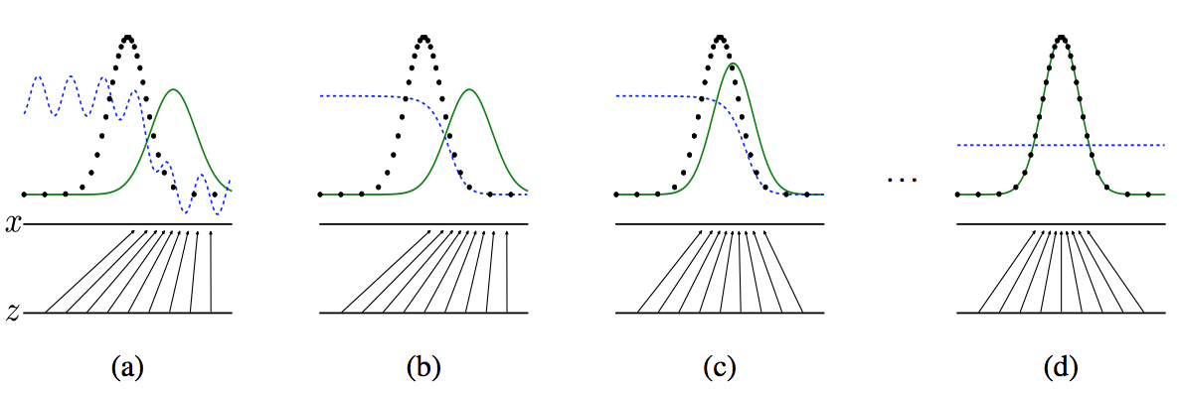
Minimax Game
Plots from the reference paper

Slide 36
Main Theoretical Result
If trained using stochastic gradient descent with sufficiently small updates then the generative distribution approaches the data distribution

Slide 37
Discussion and Further Work
Computationally advantageous as the generator network is updated only from gradients from the discriminator
No explicit representation for the generative distribution
Temperamental to how D and G are synchronized
Further work: Condition generative model/better methods coordinating training of D and G.

